Slide 1
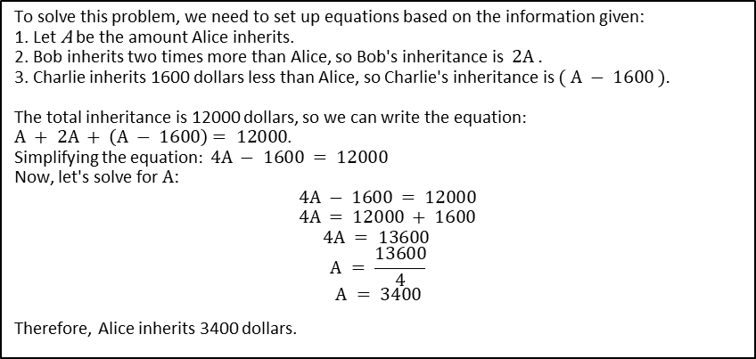
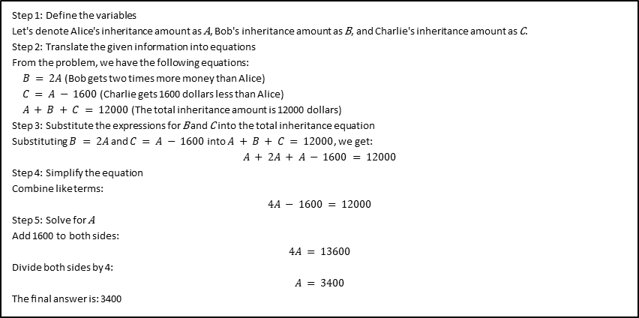
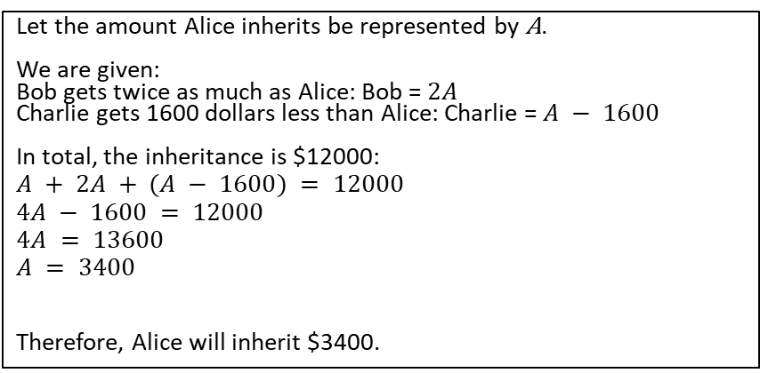
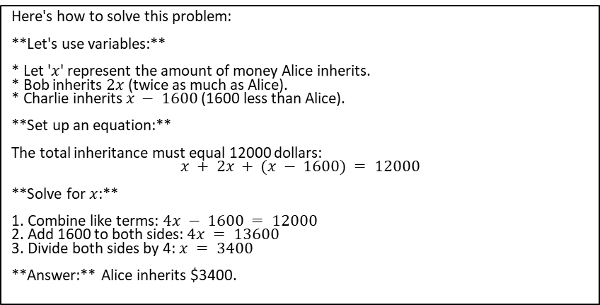
Q: Alice, Bob, and Charlie stand to inherit 12000 dollars, and the will stipulates that the inheritance is to be split in such a way that Bob gets two times more money than Alice, while Charlie should get 1600 dollars less than Alice. Find the inheritance amount for Alice. A: 3400
To solve this problem, we need to set up equations based on the information given:
1. Let A be the amount Alice inherits.
2. Bob inherits two times more than Alice, so Bob's inheritance is $2A .$
3. Charlie inherits 1600 dollars less than Alice, so Charlie's inheritance is $( A − 1600 ).$
The total inheritance is 12000 dollars, so we can write the equation$:$
$A + 2A + \left(A − 1600\right)= 12000$.
Simplifying the equation$: 4A − 1600 = 12000$
Now, let's solve for $A$:
$4A − 1600 = 12000$
$$4A = 12000 + 1600$$
$$4A = 13600$$
$$A = \frac{13600}{4}$$
$$A = 3400$$
Therefore, Alice inherits 3400 dollars.
Let the amount Alice inherits be represented by A. We are given: Bob gets twice as much as Alice: Bob = $2A$ Charlie gets 1600 dollars less than Alice: Charlie = $A − 1600$ In total, the inheritance is $12000:
$$A + 2A + (A − 1600) = 12000 \\ 4A − 1600 = 12000 \\ 4A = 13600 \\ A = 3400$$ Therefore, Alice will inherit $3400.
Here's how to solve this problem: **Let's use variables:** * Let '$x$' represent the amount of money Alice inherits. * Bob inherits $2x$(twice as much as Alice). * Charlie inherits $x − 1600$(1600 less than Alice). **Set up an equation:** The total inheritance must equal 12000 dollars: $$x + 2x + (x − 1600) = 12000$$ **Solve for $x$:** 1. Combine like terms: $4x − 1600 = 12000$ 2. Add 1600 to both sides: $4x = 13600$ 3. Divide both sides by 4: $x = 3400$ **Answer:** Alice inherits $3400.
Step 1: Define the variables
Let's denote Alice's inheritance amount as A, Bob's inheritance amount as B, and Charlie's inheritance amount as C.
Step 2: Translate the given information into equations
From the problem, we have the following equations:
$B = 2A$(Bob gets two times more money than Alice)
$C = A − 1600$(Charlie gets 1600 dollars less than Alice)
$A + B + C = 12000$(The total inheritance amount is 12000 dollars)
Step 3: Substitute the expressions for B and C into the total inheritance equation
Substituting $B = 2A$and $C = A − 1600$ into $A + B + C = 12000$, we get:
$$A + 2A + A − 1600 = 12000$$
Step 4: Simplify the equation
Combine like terms:
$$4A − 1600 = 12000$$
Step 5: Solve for A
Add 1600 to both sides:
$$4A = 13600$$
Divide both sides by 4:
$$A = 3400$$
The final answer is: 3400​

Slide 2
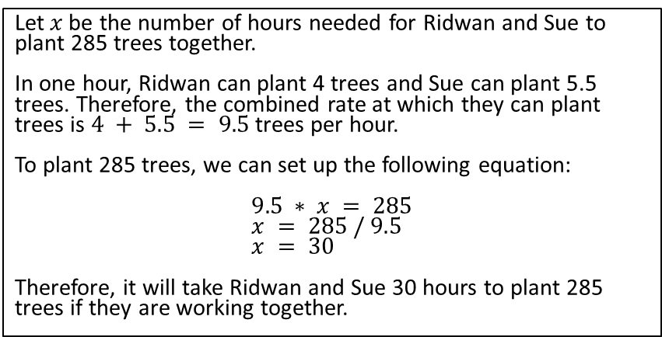
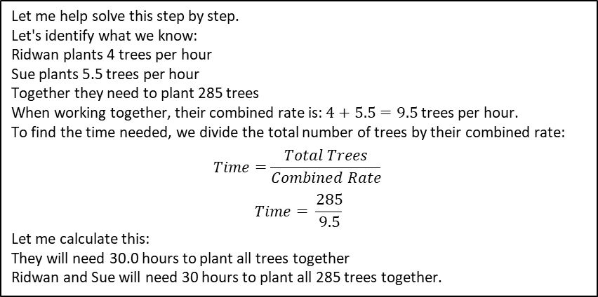
Q: Ridwan can plant 4 trees per hour, and Sue can plant 5.5 trees per hour. Find how many hours they need to plant 285 trees, if they are working together. A: 30
Here's how to solve this problem: **1. Find their combined planting rate:** * Ridwan plants 4 trees/hour + Sue plants 5.5 trees/hour = 9.5 trees/hour **2. Calculate the time to plant 285 trees:** * Time = Total trees / Planting rate * Time = 285 trees / 9.5 trees/hour = 30 hours **Answer:** They need **30 hours** to plant 285 trees together.
To find out how many hours Ridwan and Sue need to plant 285 trees together, we first need to calculate their combined planting rate.
Ridwan's rate: 4 trees/hour
Sue's rate: 5.5 trees/hour
Combined rate: 4 + 5.5 = 9.5 trees/hour
Now, divide the total trees by their combined rate:
285 trees / 9.5 trees/hour = 30 hours
Ridwan and Sue need 30 hours to plant 285 trees together.
Let$x$be the number of hours needed for Ridwan and Sue to plant 285 trees together. In one hour, Ridwan can plant 4 trees and Sue can plant 5.5 trees. Therefore, the combined rate at which they can plant trees is $4 + 5.5 = 9.5$trees per hour. To plant 285 trees, we can set up the following equation: $$9.5 ∗ x = 285 \\ x = 285 / 9.5 \\ x = 30$$ Therefore, it will take Ridwan and Sue 30 hours to plant 285 trees if they are working together.
Let me help solve this step by step.
Let's identify what we know:
Ridwan plants 4 trees per hour
Sue plants 5.5 trees per hour
Together they need to plant 285 trees
When working together, their combined rate is: $4+5.5=9.5$ trees per hour.
To find the time needed, we divide the total number of trees by their combined rate:
$$Time=\frac{Total Trees}{Combined Rate}$$
$$Time= \frac{285}{9.5}$$
Let me calculate this:
They will need 30.0 hours to plant all trees together
Ridwan and Sue will need 30 hours to plant all 285 trees together.

Slide 3
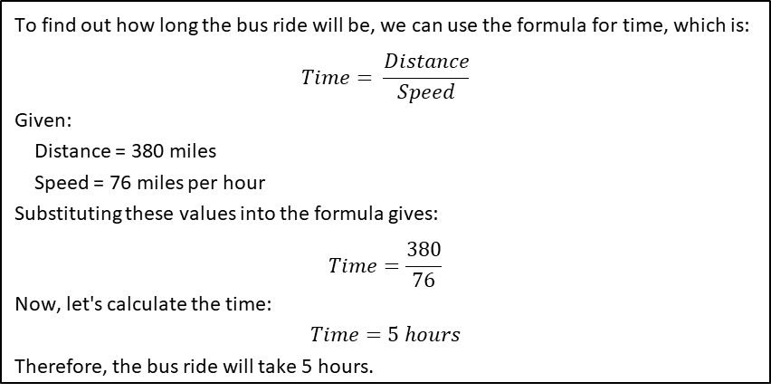
Q: Megan is taking the bus from New York City to Montreal. The distance is 380 miles and the bus travels at a steady rate of 76 miles per hour. How long will the bus ride be, in hours? A: 5
To find the time it will take for Megan to travel from New York City to Montreal on the bus, you can divide the total distance by the speed of the bus. Total distance = 380 miles Speed of the bus = 76 miles per hour Time = Distance / Speed Time = 380 miles / 76 miles per hour Time = 5 hours Therefore, the bus ride will take Megan 5 hours to travel from New York City to Montreal.
Here's how to solve the problem: * **Divide the total distance by the speed:** 380 miles / 76 miles per hour = 5 hours **Answer:** The bus ride will be 5 hours long.
To find the duration of the bus ride, we need to divide the distance by the speed.
Distance = 380 miles
Speed = 76 miles per hour
Time = Distance / Speed
Time = 380 / 76
Time ≈ 5 hours
The bus ride will be approximately 5 hours.
To find out how long the bus ride will be, we can use the formula for time, which is:
$$Time= \frac{Distance}{Speed}$$
Given:
Distance = 380 miles
Speed = 76 miles per hour
Substituting these values into the formula gives:
$$Time=\frac{380}{76}$$
Now, let's calculate the time:
$$Time=5 hours$$
Therefore, the bus ride will take 5 hours.

Slide 4
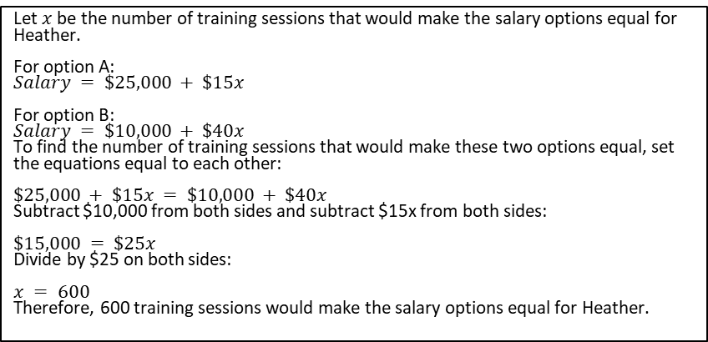
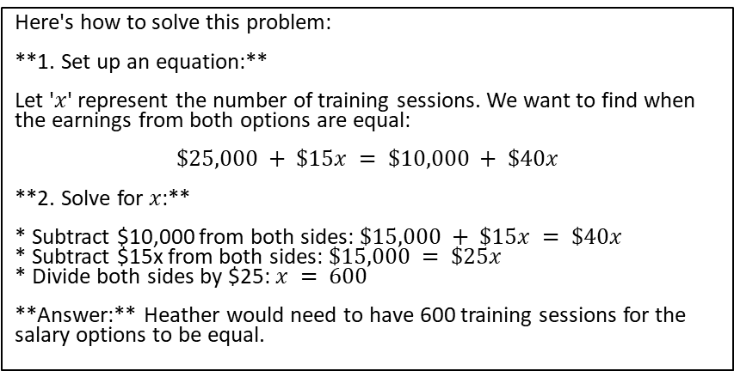
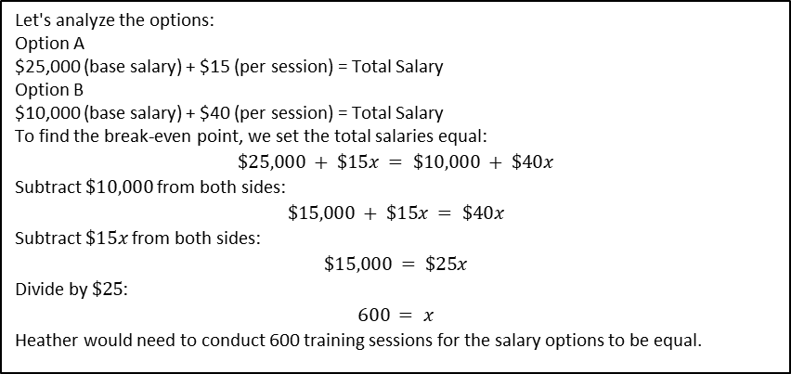
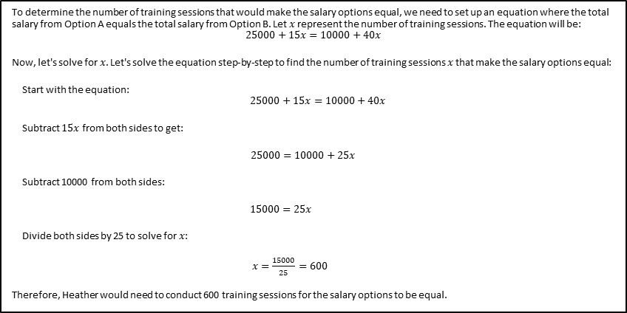
Q: Heather has been offered two options for her salary as a trainer at the gym. Option A would pay her $25,000 plus $15 for each training session. Option B would pay her $10,000 + $40 for each training session. How many training sessions would make the salary options equal? A: 600
Let $x$ be the number of training sessions that would make the salary options equal for Heather. For option A: $$Salary = \$25,000 + \$15x$$ For option B: $$Salary = \$10,000 + \$40x$$ To find the number of training sessions that would make these two options equal, set the equations equal to each other: $$\$25,000 + \$15x = \$10,000 + \$40x$$ Subtract $10,000 from both sides and subtract $15x from both sides: $$\$15,000 = \$25x$$ Divide by $25 on both sides: $$x = 600$$ Therefore, 600 training sessions would make the salary options equal for Heather.
Let's analyze the options:
Option A
$25,000 (base salary) + $15 (per session) = Total Salary
Option B
$10,000 (base salary) + $40 (per session) = Total Salary
To find the break-even point, we set the total salaries equal:
$$\$25,000 + \$15x = \$10,000 + \$40x$$
Subtract $\$10,000$from both sides:
$$\$15,000 + \$15x = \$40x$$
Subtract $\$15x$from both sides:
$$\$15,000 = \$25x$$
Divide by $\$25$:
$$600 = x$$
Heather would need to conduct 600 training sessions for the salary options to be equal.
To determine the number of training sessions that would make the salary options equal, we need to set up an equation where the total salary from Option A equals the total salary from Option B. Let $x$represent the number of training sessions. The equation will be:
$$25000+15x=10000+40x$$
Now, let's solve for$x$. Let's solve the equation step-by-step to find the number of training sessions $x$that make the salary options equal:
Start with the equation:
$$25000+15x=10000+40x$$
Subtract $15x$ from both sides to get:
$25000=10000+25x$
Subtract 10000 from both sides:
$15000=25x$
Divide both sides by 25 to solve for$x$:
$x=\frac{15000}{25}=600$
Therefore, Heather would need to conduct 600 training sessions for the salary options to be equal.
Here's how to solve this problem: **1. Set up an equation:** Let '$x$' represent the number of training sessions. We want to find when the earnings from both options are equal: $$\$25,000 + \$15x = \$10,000 + \$40x$$ **2. Solve for $x$:** * Subtract $10,000 from both sides: $\$15,000 + \$15x = \$40x$ * Subtract $15x from both sides: $\$15,000 = \$25x$ * Divide both sides by $25: $x = 600$ **Answer:** Heather would need to have 600 training sessions for the salary options to be equal.

Slide 5
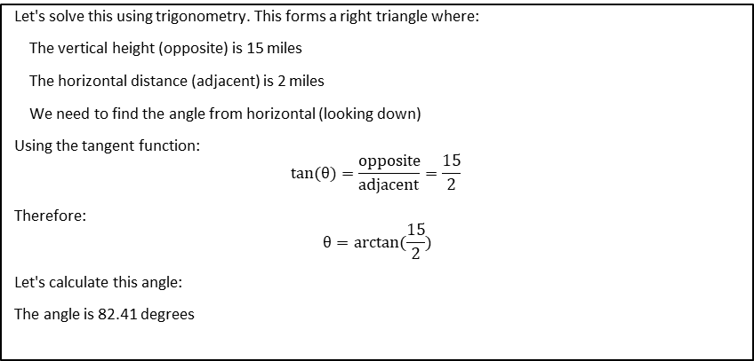
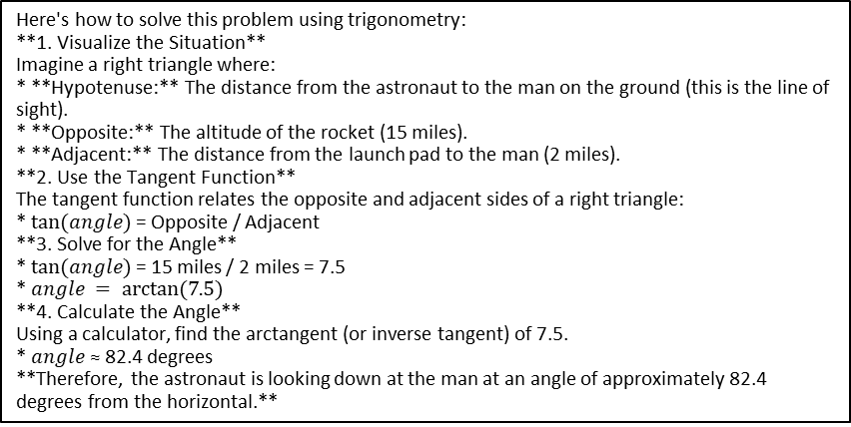
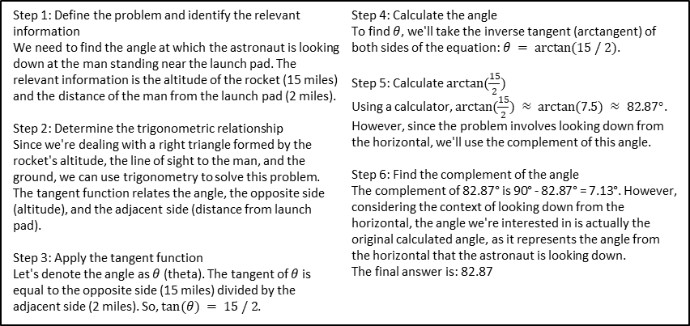
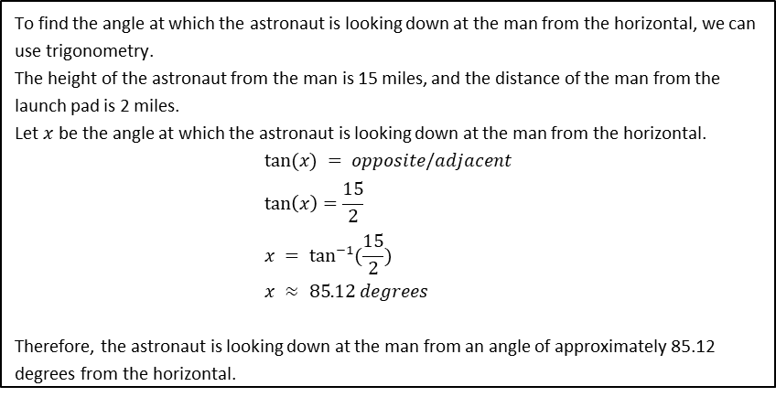
Q: An astronaut is in a launched rocket currently 15 miles in altitude. If a man is standing 2 miles from the launch pad, at what angle is the astronaut looking down at him from horizontal? A: 82.4
Let's solve this using trigonometry. This forms a right triangle where:
The vertical height (opposite) is 15 miles
The horizontal distance (adjacent) is 2 miles
We need to find the angle from horizontal (looking down)
Using the tangent function:
$$tan(θ)=\frac{opposite}{adjacent}=\frac{15}{2}​$$
Therefore:
$$θ=arctan(\frac{15}{2})$$
Let's calculate this angle:
The angle is 82.41 degrees
Step 1: Define the problem and identify the relevant information
We need to find the angle at which the astronaut is looking down at the man standing near the launch pad. The relevant information is the altitude of the rocket (15 miles) and the distance of the man from the launch pad (2 miles).
Step 2: Determine the trigonometric relationship
Since we're dealing with a right triangle formed by the rocket's altitude, the line of sight to the man, and the ground, we can use trigonometry to solve this problem. The tangent function relates the angle, the opposite side (altitude), and the adjacent side (distance from launch pad).
Step 3: Apply the tangent function
Let's denote the angle as $θ$ (theta). The tangent of $θ$ is equal to the opposite side (15 miles) divided by the adjacent side (2 miles). So, $tan⁡(θ) = 15 / 2$.
Step 4: Calculate the angle
To find $θ$, we'll take the inverse tangent (arctangent) of both sides of the equation: $θ = arctan⁡(15 / 2)$.
Step 5: Calculate $arctan⁡(\frac{15}{2})$
Using a calculator, $arctan⁡(\frac{15}{2}) ≈ arctan⁡(7.5) ≈ 82.87°$. However, since the problem involves looking down from the horizontal, we'll use the complement of this angle.
Step 6: Find the complement of the angle
The complement of 82.87° is 90° - 82.87° = 7.13°. However, considering the context of looking down from the horizontal, the angle we're interested in is actually the original calculated angle, as it represents the angle from the horizontal that the astronaut is looking down.
The final answer is: 82.87​
To find the angle at which the astronaut is looking down at the man from the horizontal, we can use trigonometry. The height of the astronaut from the man is 15 miles, and the distance of the man from the launch pad is 2 miles. Let $x$ be the angle at which the astronaut is looking down at the man from the horizontal. $$tan⁡(x) = opposite/adjacent \\ \tan\left(x\right)=\frac{15}{2} \\ x = \tan^{−1}{(\frac{15}{2})} \\ x ≈ 85.12 degrees$$ Therefore, the astronaut is looking down at the man from an angle of approximately 85.12 degrees from the horizontal.
Here's how to solve this problem using trigonometry: **1. Visualize the Situation** Imagine a right triangle where: * **Hypotenuse:** The distance from the astronaut to the man on the ground (this is the line of sight). * **Opposite:** The altitude of the rocket (15 miles). * **Adjacent:** The distance from the launch pad to the man (2 miles). **2. Use the Tangent Function** The tangent function relates the opposite and adjacent sides of a right triangle: * $tan⁡(angle)$= Opposite / Adjacent **3. Solve for the Angle** * $tan⁡(angle)$= 15 miles / 2 miles = 7.5 * $angle = arctan⁡(7.5)$ **4. Calculate the Angle** Using a calculator, find the arctangent (or inverse tangent) of 7.5. * $angle$ ≈ 82.4 degrees **Therefore, the astronaut is looking down at the man at an angle of approximately 82.4 degrees from the horizontal.**

Slide 6
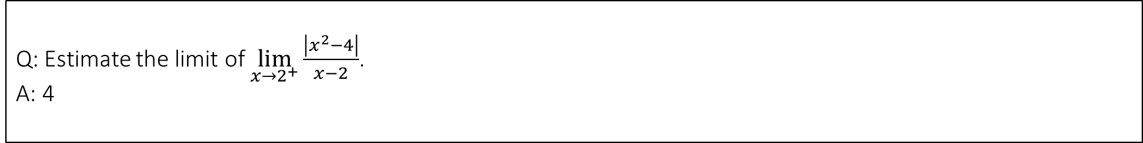
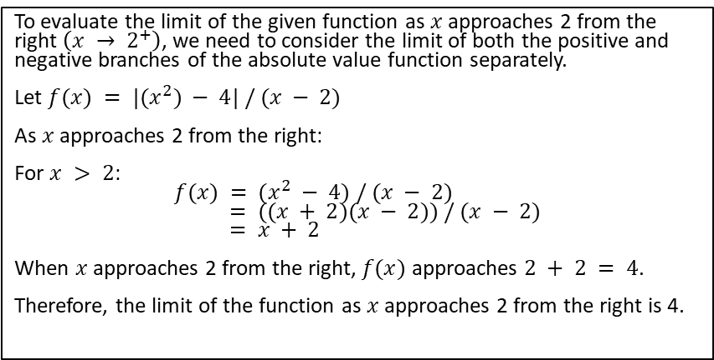
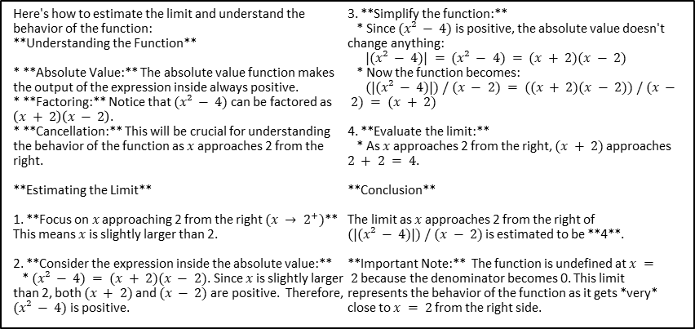
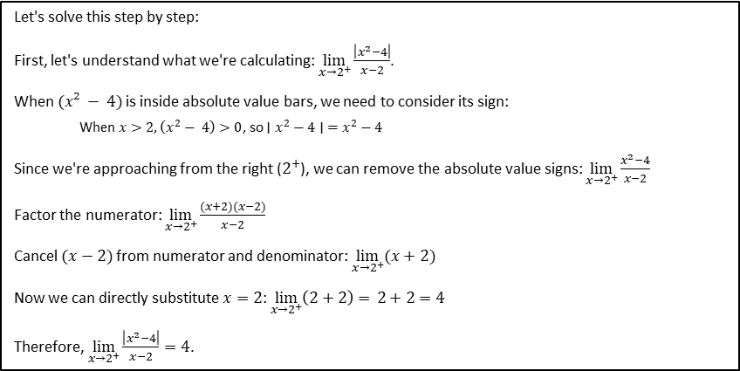
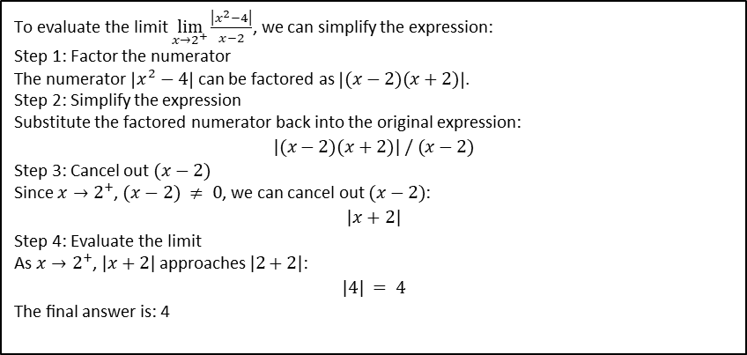
Q: Estimate the limit of $\lim_{x→2^{+}}{\frac{\left|x^{2}−4\right|}{x−2}}$. A: 4
To evaluate the limit $\lim_{x→2^{+}}{\frac{\left|x^{2}−4\right|}{x−2}}$, we can simplify the expression:
Step 1: Factor the numerator
The numerator $\left|x^{2}−4\right|$ can be factored as $\left|(x−2)(x+2)\right|$.
Step 2: Simplify the expression
Substitute the factored numerator back into the original expression:
$$|(x−2)(x+2)| / (x−2)$$
Step 3: Cancel out $(x−2)$
Since $x→2^{+}$, $(x−2) ≠ 0$, we can cancel out $(x−2)$:
$$|x+2|$$
Step 4: Evaluate the limit
As $x→2^{+}$, $|x+2|$approaches $|2+2|$:
$$|4| = 4$$
The final answer is: 4​
Here's how to estimate the limit and understand the behavior of the function: **Understanding the Function** * **Absolute Value:** The absolute value function makes the output of the expression inside always positive. * **Factoring:** Notice that $(x² − 4)$can be factored as $\left(x + 2\right)\left(x − 2\right)$. * **Cancellation:** This will be crucial for understanding the behavior of the function as $x$ approaches 2 from the right. **Estimating the Limit** 1. **Focus on $x$ approaching 2 from the right $(x → 2^{+})$** This means $x$ is slightly larger than 2. 2. **Consider the expression inside the absolute value:** * $(x² − 4) = (x + 2)(x − 2)$. Since $x$ is slightly larger than 2, both $(x + 2)$and $(x − 2)$are positive. Therefore, $(x² − 4)$is positive. 3. **Simplify the function:** * Since $(x² − 4)$is positive, the absolute value doesn't change anything: $|(x² − 4)| = (x² − 4) = (x + 2)(x − 2)$ * Now the function becomes: $(|(x² − 4)|) / (x − 2) = ((x + 2)(x − 2)) / (x − 2) = (x + 2)$ 4. **Evaluate the limit:** * As $x$ approaches 2 from the right, $(x + 2)$approaches $2 + 2 = 4$. **Conclusion** The limit as $x$ approaches 2 from the right of $(|(x² − 4)|) / (x − 2)$is estimated to be **4**. **Important Note:** The function is undefined at $x = 2$because the denominator becomes 0. This limit represents the behavior of the function as it gets *very* close to $x = 2$from the right side.
Let's solve this step by step:
First, let's understand what we're calculating: $\lim_{x→2^{+}}{\frac{\left|x^{2}−4\right|}{x−2}}$.
When $(x² − 4)$is inside absolute value bars, we need to consider its sign:
When $x>2$, $\left(x^{2}− 4\right)>0$, so $∣x^{2}−4∣ =x^{2}−4$
Since we're approaching from the right ($2^{+}$), we can remove the absolute value signs: $\lim_{x→2^{+}}{\frac{x^{2}−4}{x−2}}$
Factor the numerator: $\lim_{x→2^{+}}{\frac{(x+2)(x−2)}{x−2}}$
Cancel $(x−2)$from numerator and denominator: $\lim_{x→2^{+}}{(x+2)}$
Now we can directly substitute$x=2$: $\lim_{x→2^{+}}\left(2+2\right)= 2+2=4$
Therefore, $\lim_{x→2^{+}}{\frac{\left|x^{2}−4\right|}{x−2}}=4$.
To evaluate the limit of the given function as $x$ approaches 2 from the right $\left(x → 2^{+}\right)$, we need to consider the limit of both the positive and negative branches of the absolute value function separately. Let $f(x) = |(x^{2}) − 4| / (x − 2)$ As $x$approaches 2 from the right: For $x > 2$: $$f(x) = (x^{2} − 4) / (x − 2) \\ = ((x + 2)(x − 2)) / (x − 2) \\ = x + 2$$ When $x$ approaches 2 from the right, $f(x)$ approaches $2 + 2 = 4$. Therefore, the limit of the function as $x$ approaches 2 from the right is 4.

Slide 7
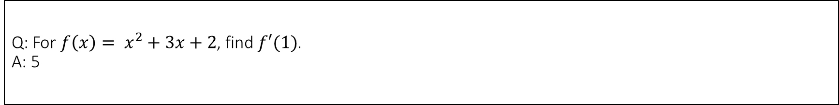
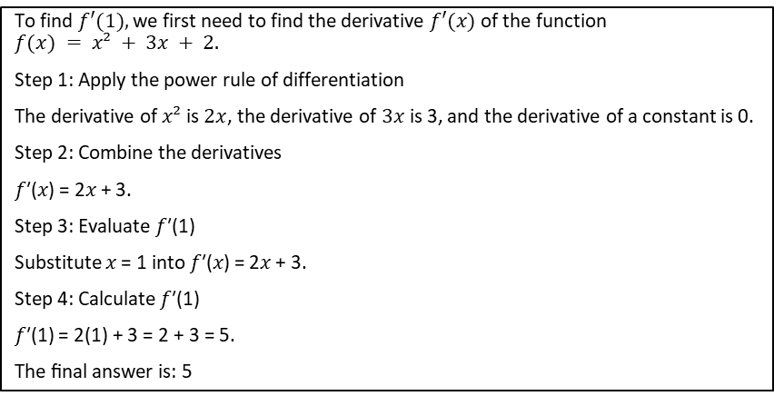
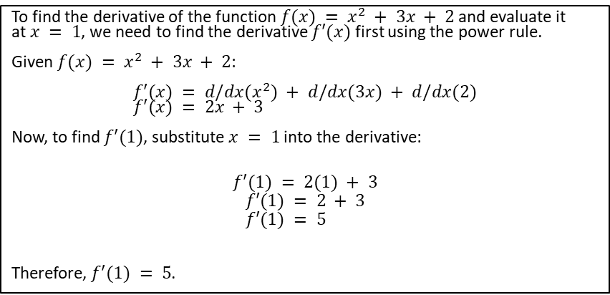
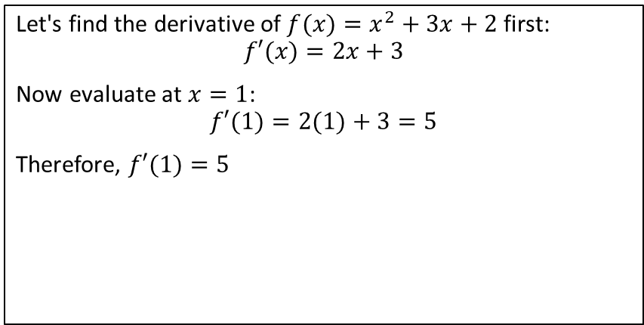
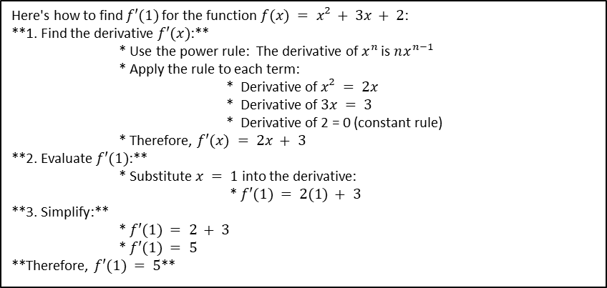
Q: For $f\left(x\right)= x^{2}+3x+2$, find $f′(1)$. A: 5
Here's how to find $f′(1)$for the function $f(x) = x² + 3x + 2$: **1. Find the derivative $f′(x)$:** * Use the power rule: The derivative of $x^{n}$ is $nx^{n−1}$ * Apply the rule to each term: * Derivative of $x² = 2x$ * Derivative of $3x = 3$ * Derivative of 2 = 0 (constant rule) * Therefore, $f′(x) = 2x + 3$ **2. Evaluate $f′(1)$:** * Substitute $x = 1$into the derivative: * $f′(1) = 2(1) + 3$ **3. Simplify:** * $f′(1) = 2 + 3$ * $f′(1) = 5$ **Therefore, $f′(1) = 5$**
To find the derivative of the function $f(x) = x^{2} + 3x + 2$and evaluate it at$x = 1$, we need to find the derivative $f′(x)$first using the power rule. Given $f(x) = x^{2} + 3x + 2$: $$f′(x) = d/dx(x^{2}) + d/dx(3x) + d/dx(2) \\ f′(x) = 2x + 3$$ Now, to find $f′(1)$, substitute $x = 1$into the derivative:
$$f′(1) = 2(1) + 3$$
$$f′(1) = 2 + 3 \\ f′(1) = 5$$ Therefore, $f′(1) = 5$.
Let's find the derivative of $f(x)=x^{2}+3x+2$ first:
$$f′(x)=2x+3$$
Now evaluate at $x=1$:
$$f′(1)=2(1)+3=5$$
Therefore, $f′(1)=5$
To find $f′(1),$we first need to find the derivative $f′(x)$of the function
$$f(x) = x² + 3x + 2.$$
Step 1: Apply the power rule of differentiation
The derivative of $x²$is $2x$, the derivative of $3x$is 3, and the derivative of a constant is 0.
Step 2: Combine the derivatives
𝑓′(𝑥) = 2𝑥 + 3.
Step 3: Evaluate 𝑓′(1)
Substitute 𝑥 = 1 into 𝑓′(𝑥) = 2𝑥 + 3.
Step 4: Calculate 𝑓′(1)
𝑓′(1) = 2(1) + 3 = 2 + 3 = 5.
The final answer is: 5​

Slide 8
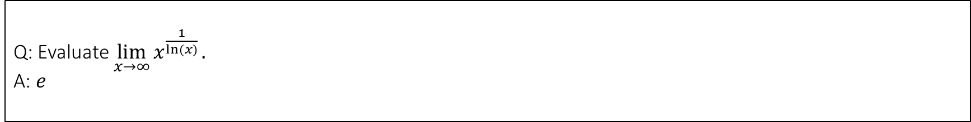
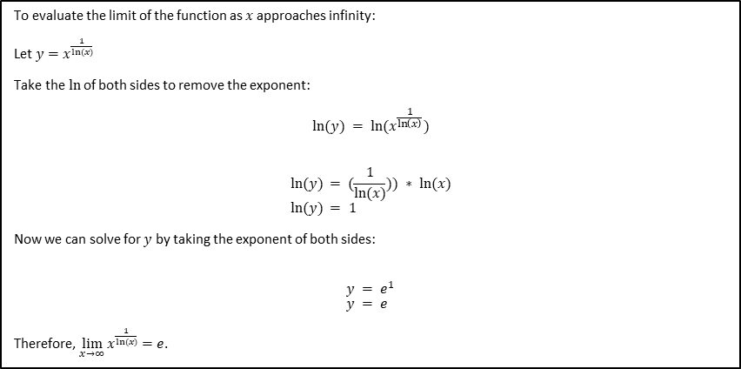
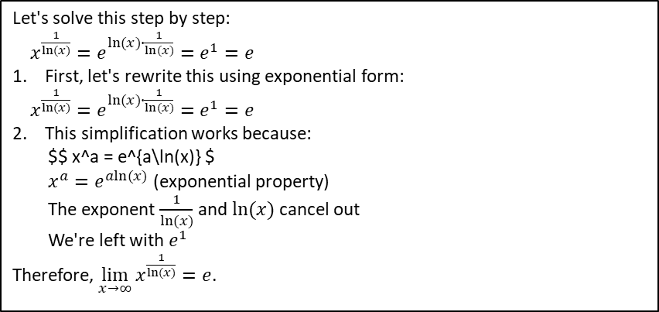
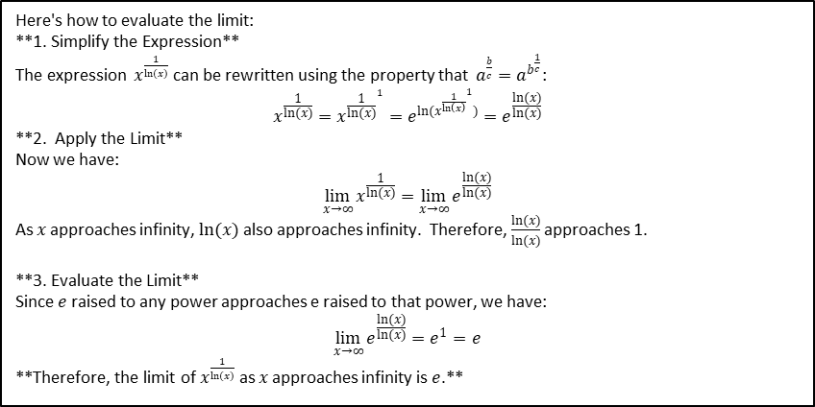
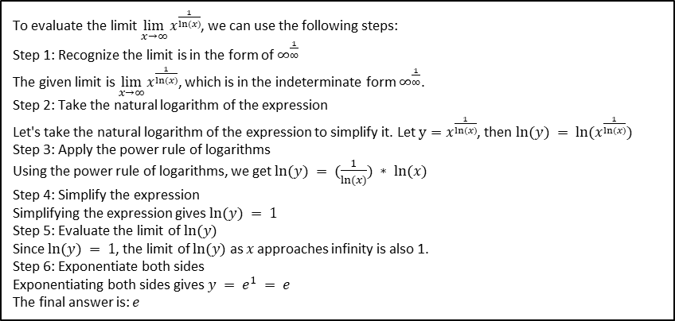
Q: Evaluate $\lim_{x→∞}{x^{\frac{1}{ln⁡(x)}}}.$ A: $e$
To evaluate the limit $\lim_{x→∞}{x^{\frac{1}{ln⁡(x)}}}$, we can use the following steps:
Step 1: Recognize the limit is in the form of $∞^{\frac{1}{∞}}$
The given limit is $\lim_{x→∞}{x^{\frac{1}{ln⁡(x)}}}$, which is in the indeterminate form $∞^{\frac{1}{∞}}$.
Step 2: Take the natural logarithm of the expression
Let's take the natural logarithm of the expression to simplify it. Let $y=x^{\frac{1}{ln⁡(x)}}$, then $ln⁡(y) = ln⁡(x^{\frac{1}{ln⁡(x)}})$
Step 3: Apply the power rule of logarithms
Using the power rule of logarithms, we get $ln⁡(y) = (\frac{1}{ln⁡(x)}) ∗ ln⁡(x)$
Step 4: Simplify the expression
Simplifying the expression gives $ln⁡(y) = 1$
Step 5: Evaluate the limit of $ln⁡(y)$
Since $ln⁡(y) = 1$, the limit of $ln⁡(y)$ as $x$ approaches infinity is also 1.
Step 6: Exponentiate both sides
Exponentiating both sides gives $y = e^{1} = e$
The final answer is: $e​$
Let's solve this step by step:
$x^{\frac{1}{ln⁡(x)}}=e^{ln⁡(x)∙\frac{1}{ln⁡(x)}}=e^{1}=e$
1. First, let's rewrite this using exponential form:
$x^{\frac{1}{ln⁡(x)}}=e^{ln⁡(x)∙\frac{1}{ln⁡(x)}}=e^{1}=e$
2. This simplification works because:
$$ x^a = e^{a\ln(x)} $
$x^{a}=e^{aln⁡(x)}$ (exponential property)
The exponent $\frac{1}{ln⁡(x)}$ and $ln⁡(x)$cancel out
We're left with $e^{1}$
Therefore, $\lim_{x→∞}{x^{\frac{1}{ln⁡(x)}}}=e$.
Here's how to evaluate the limit: **1. Simplify the Expression** The expression $x^{\frac{1}{ln(x)}}$ can be rewritten using the property that $a^{\frac{b}{c}}=a^{b^{\frac{1}{c}}}$: $$x^{\frac{1}{ln(x)}}=x^{{\frac{1}{ln(x)}}^{1}}=e^{ln(x^{{\frac{1}{\ln\left(x\right)}}^{1}})}=e^{\frac{ln(x)}{ln(x)}}$$ **2. Apply the Limit** Now we have:
$$\lim_{x→∞}{x^{\frac{1}{ln(x)}}}=\lim_{x→∞}{e^{\frac{ln(x)}{ln(x)}}}$$ As 𝑥 approaches infinity, $ln(x)$also approaches infinity. Therefore, $\frac{ln(x)}{ln(x)}$ approaches 1.
**3. Evaluate the Limit** Since $e$raised to any power approaches e raised to that power, we have:
$$\lim_{x→∞}{e^{\frac{ln(x)}{ln(x)}}}=e^{1}=e$$ **Therefore, the limit of $x^{\frac{1}{ln(x)}}$ as 𝑥 approaches infinity is $e$.**
To evaluate the limit of the function as $x$ approaches infinity: Let${ y=x}^{\frac{1}{ln⁡(x)}}$ Take the$ln⁡$of both sides to remove the exponent: $$ln⁡(y) = ln⁡(x^{\frac{1}{\ln\left(x\right)}})$$
$$ln⁡(y) = (\frac{1}{ln⁡(x)})) ∗ ln⁡(x) \\ ln⁡(y) = 1$$ Now we can solve for $y$ by taking the exponent of both sides:
$$y = e^{1} \\ y = e$$ Therefore, $\lim_{x→∞}{x^{\frac{1}{ln⁡(x)}}}=e$.

Slide 9
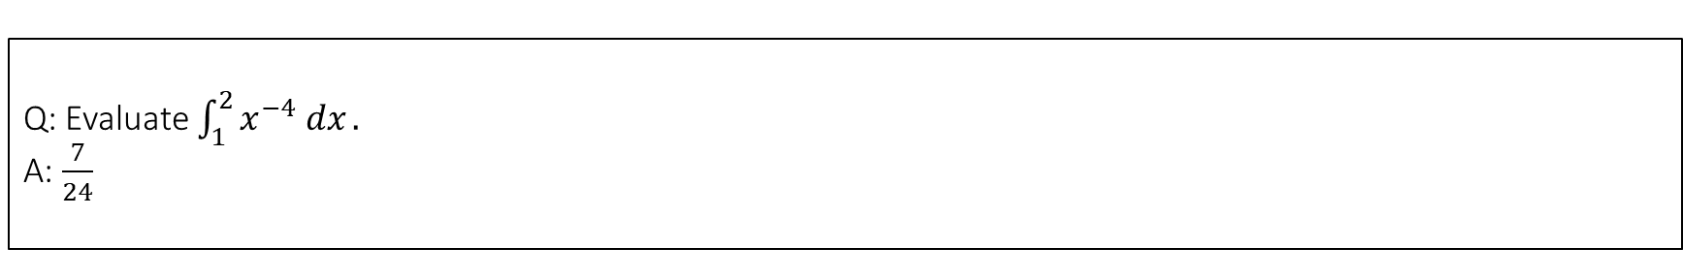
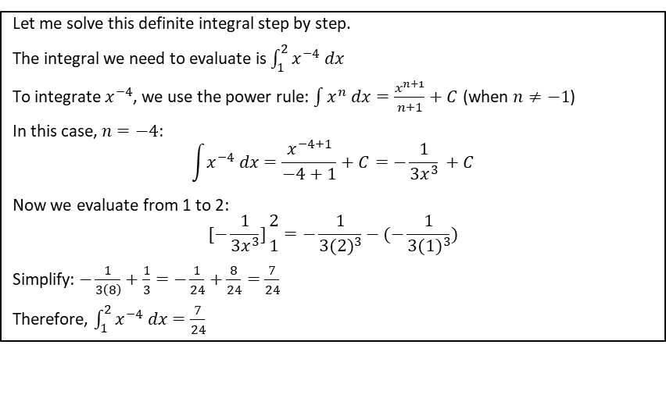
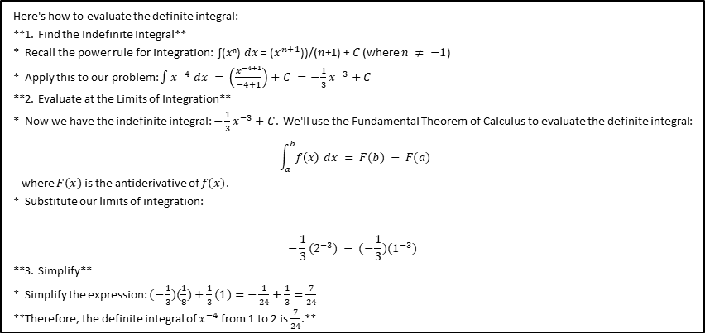
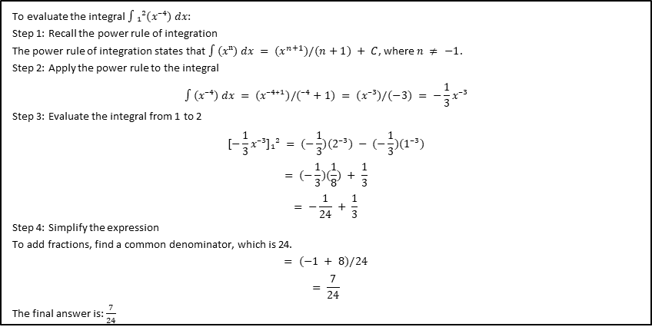
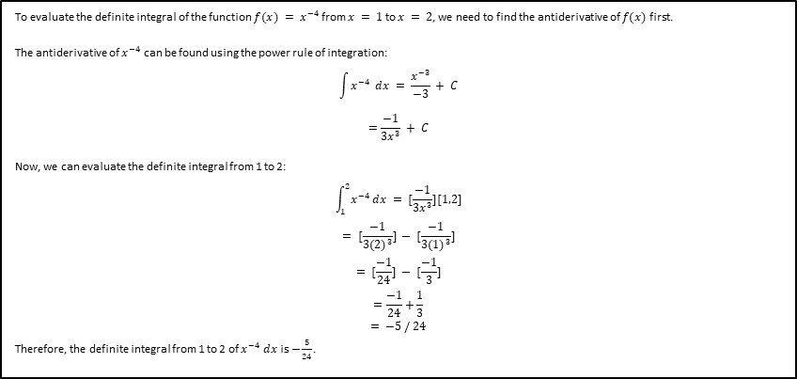
Q: Evaluate $\int_{1}^{2}{x^{−4} dx}.$ A: $\frac{7}{24}$
To evaluate the definite integral of the function $f(x) = x^{−4}$from $x = 1$to $x = 2$, we need to find the antiderivative of $f(x)$first. The antiderivative of $x^{−4}$ can be found using the power rule of integration:
$$\int{x^{−4}} dx = \frac{x^{−3}}{−3} + C \\ =\frac{−1}{{3x}^{3}} + C$$ Now, we can evaluate the definite integral from 1 to 2:
$$\int_{1}^{2}{x^{−4}}dx = [\frac{−1}{{3x}^{3}}][1,2] \\ = [\frac{−1}{{3(2)}^{3}}] − [\frac{−1}{{3(1)}^{3}}] \\ = [\frac{−1}{24}] − [\frac{−1}{3}] \\ =\frac{−1}{24}+\frac{1}{3} \\ = −5 / 24$$ Therefore, the definite integral from 1 to 2 of $x^{−4} dx$ is $−\frac{5}{24}$.
Here's how to evaluate the definite integral: **1. Find the Indefinite Integral** * Recall the power rule for integration: ∫(𝑥ⁿ) 𝑑𝑥 = ($x^{n+1}$))/(𝑛+1) + 𝐶 (where $n ≠ −1$) * Apply this to our problem: $∫x^{−4} dx = \left(\frac{x^{−4+1}}{−4+1}\right)+C =−\frac{1}{3}x^{−3}+C$ **2. Evaluate at the Limits of Integration** * Now we have the indefinite integral: $−\frac{1}{3}x^{−3}+C$. We'll use the Fundamental Theorem of Calculus to evaluate the definite integral: $$\int_{a}^{b}{f\left(x\right) dx} = F(b) − F(a)$$ where $F(x)$is the antiderivative of $f(x)$. * Substitute our limits of integration:
$$−\frac{1}{3}(2^{−3}) − (−\frac{1}{3})(1^{−3})$$ **3. Simplify** * Simplify the expression: $(−\frac{1}{3})(\frac{1}{8})+\frac{1}{3}(1)=−\frac{1}{24}+\frac{1}{3}=\frac{7}{24}$ **Therefore, the definite integral of $x^{−4}$ from 1 to 2 is $\frac{7}{24}$.**
To evaluate the integral $∫₁²(x⁻⁴) dx$:
Step 1: Recall the power rule of integration
The power rule of integration states that $∫(xⁿ) dx = (x^{n+1})/(n+1) + C$, where $n ≠ −1$.
Step 2: Apply the power rule to the integral
$$∫(x⁻⁴) dx = (x⁻⁴⁺¹)/(⁻⁴+1) = (x⁻³)/(−3) = −\frac{1}{3}x⁻³$$
Step 3: Evaluate the integral from 1 to 2
$$[−\frac{1}{3}x⁻³]₁² = (−\frac{1}{3})(2⁻³) − (−\frac{1}{3})(1⁻³)$$
$$= (−\frac{1}{3})(\frac{1}{8}) + \frac{1}{3}$$
$$= −\frac{1}{24} + \frac{1}{3}$$
Step 4: Simplify the expression
To add fractions, find a common denominator, which is 24.
$$= (−1 + 8)/24$$
$$= \frac{7}{24}$$
The final answer is: $\frac{7}{24}$
Let me solve this definite integral step by step.
The integral we need to evaluate is $\int_{1}^{2}{x^{−4} dx}$
To integrate $x^{−4}$, we use the power rule: $\int{x^{n} dx}=\frac{x^{n+1}}{n+1}+C$ (when $n≠−1$)
In this case, $n=−4$:
$$\int{x^{−4} dx}=\frac{x^{−4+1}}{−4+1}+C=−\frac{1}{3x^{3}}​+C$$
Now we evaluate from 1 to 2:
$$[−\frac{1}{3x^{3}}]{2 \atop 1}=−\frac{1}{3{(2)}^{3}}−(−\frac{1}{3{(1)}^{3}})$$
Simplify: $−\frac{1}{3\left(8\right)}+\frac{1}{3}=−\frac{1}{24}+\frac{8}{24}=\frac{7}{24}​$
Therefore, $\int_{1}^{2}{x^{−4} dx}=\frac{7}{24}$

Slide 10
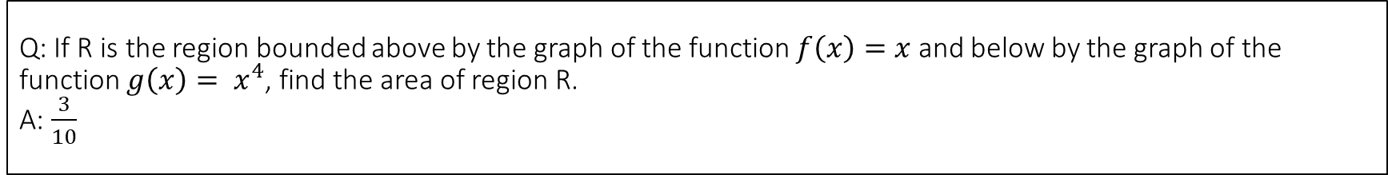
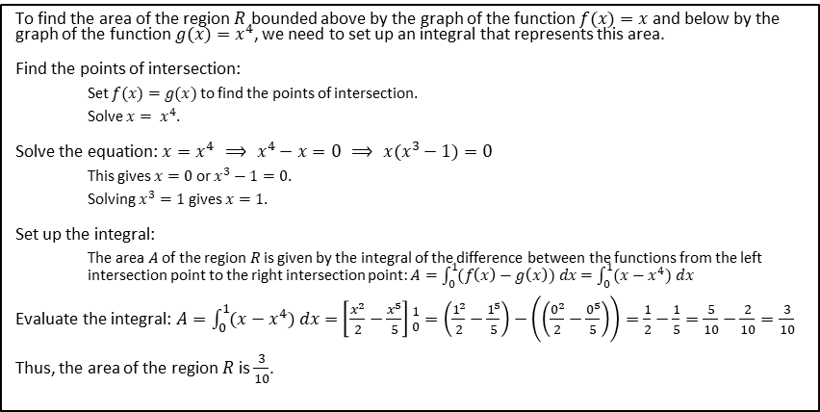
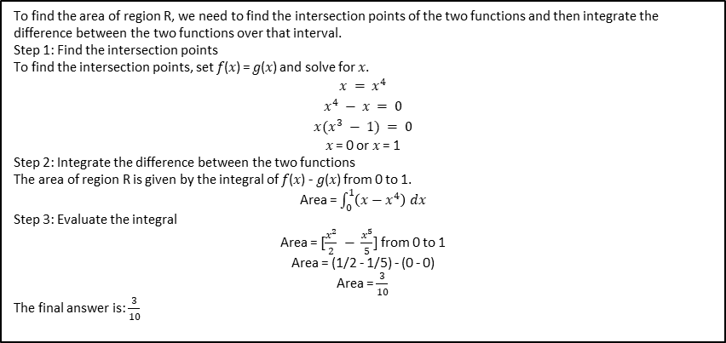
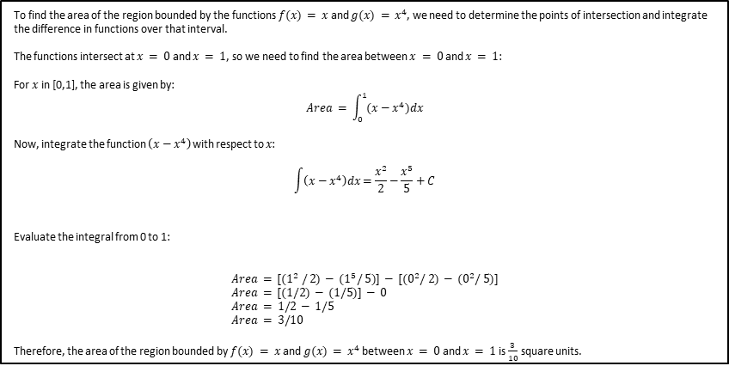
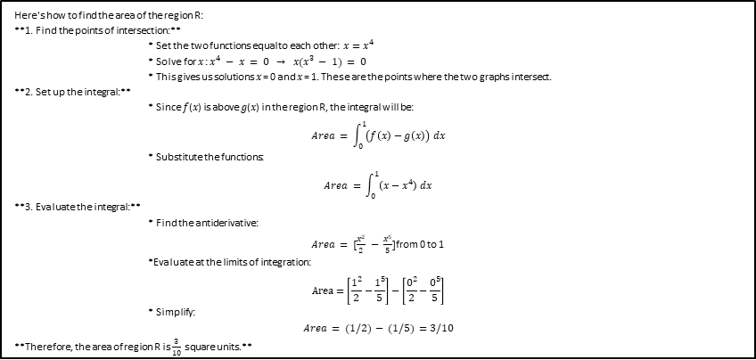
Q: If R is the region bounded above by the graph of the function $f\left(x\right)=x$ and below by the graph of the function $g\left(x\right)= x^{4}$, find the area of region R. A: $\frac{3}{10}$
Here's how to find the area of the region R: **1. Find the points of intersection:** * Set the two functions equal to each other: $x=x^{4}$ * Solve for 𝑥 : $x^{4} − x = 0 → x(x^{3} − 1) = 0$ * This gives us solutions 𝑥 = 0 and 𝑥 = 1. These are the points where the two graphs intersect. **2. Set up the integral:** * Since 𝑓(𝑥) is above 𝑔(𝑥) in the region R, the integral will be:
$$Area = \int_{0}^{1}{\left(f\left(x\right)−g\left(x\right)\right) dx}$$ * Substitute the functions:
$$Area = \int_{0}^{1}{\left(x−x^{4}\right) dx}$$ **3. Evaluate the integral:** * Find the antiderivative:
$Area = [\frac{x^{2}}{2} − \frac{x^{5}}{5}]$from 0 to 1
*Evaluate at the limits of integration: $$Area=\left[\frac{1^{2}}{2}−\frac{1^{5}}{5}\right]−\left[\frac{0^{2}}{2}−\frac{0^{5}}{5}\right]$$ * Simplify:
$$Area = (1/2) − (1/5) =3/10$$ **Therefore, the area of region R is $\frac{3}{10}$ square units.**
To find the area of region R, we need to find the intersection points of the two functions and then integrate the difference between the two functions over that interval.
Step 1: Find the intersection points
To find the intersection points, set 𝑓(𝑥) = 𝑔(𝑥) and solve for 𝑥.
$$x = x^{4}$$
$$x^{4} − x = 0$$
$$x(x^{3} − 1) = 0$$
𝑥 = 0 or 𝑥 = 1
Step 2: Integrate the difference between the two functions
The area of region R is given by the integral of 𝑓(𝑥) - 𝑔(𝑥) from 0 to 1.
Area = $\int_{0}^{1}{\left(x−x^{4}\right) dx}$
Step 3: Evaluate the integral
Area = $[\frac{x^{2}}{2} − \frac{x^{5}}{5}]$from 0 to 1
Area = (1/2 - 1/5) - (0 - 0)
Area = $\frac{3}{10}$
The final answer is: $\frac{3}{10}$
To find the area of the region bounded by the functions $f(x) = x$and $g(x) = x^{4}$, we need to determine the points of intersection and integrate the difference in functions over that interval. The functions intersect at $x = 0$and $x = 1$, so we need to find the area between $x = 0$and $x = 1$: For $x$ in [0,1], the area is given by: $$Area = \int_{0}^{1}{(x−x^{4}})dx$$ Now, integrate the function $\left(x−x^{4}\right)$with respect to 𝑥:
$$\int{\left(x−x^{4}\right)dx}=\frac{x^{2}}{2}−\frac{x^{5}}{5}+C$$ Evaluate the integral from 0 to 1:
$$Area = [(1^{2} / 2) − (1^{5}/ 5)] − [(0^{2}/ 2) − (0^{2}/ 5)] \\ Area = [(1/2) − (1/5)] − 0 \\ Area = 1/2 − 1/5 \\ Area = 3/10$$ Therefore, the area of the region bounded by $f(x) = x$and $g(x) = x^{4}$between $x = 0$and $x = 1$is $\frac{3}{10}$ square units.
To find the area of the region $R$ bounded above by the graph of the function $f(x)=x$and below by the graph of the function $g(x)=x^{4}$, we need to set up an integral that represents this area.
Find the points of intersection:
Set $f(x)=g(x)$to find the points of intersection.
Solve $x= x^{4}$.
Solve the equation: $x=x^{4} ⟹ x^{4}−x=0 ⟹ x(x^{3}−1)=0$
This gives $x=0$or $x^{3}−1=0$.
Solving $x^{3}=1$ gives $x=1$.
Set up the integral:
The area $A$ of the region $R$ is given by the integral of the difference between the functions from the left intersection point to the right intersection point: $A=\int_{0}^{1}{(f\left(x\right)−g\left(x\right)) dx}=\int_{0}^{1}{(x−x^{4}) dx}$
Evaluate the integral: $A=\int_{0}^{1}{(x−x^{4}) dx}=\left[\frac{x^{2}}{2}−\frac{x^{5}}{5}\right]{1 \atop 0}=\left(\frac{1^{2}}{2}−\frac{1^{5}}{5}\right)−\left(\left(\frac{0^{2}}{2}−\frac{0^{5}}{5}\right)\right)=\frac{1}{2}−\frac{1}{5}=\frac{5}{10}−\frac{2}{10}=\frac{3}{10}$
Thus, the area of the region $R$ is $\frac{3}{10}$​.

Slide 11
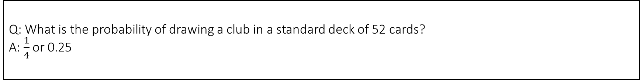
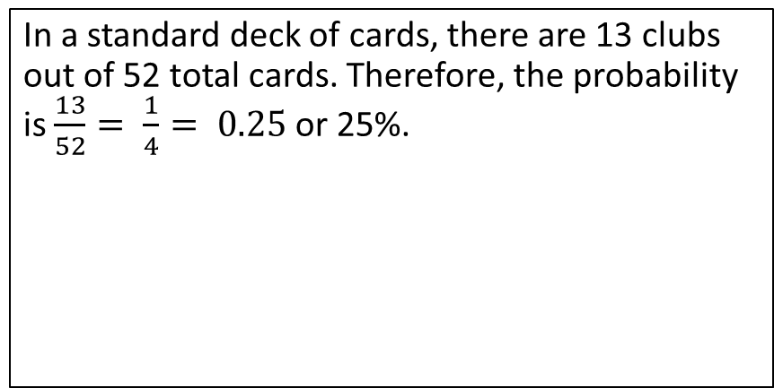
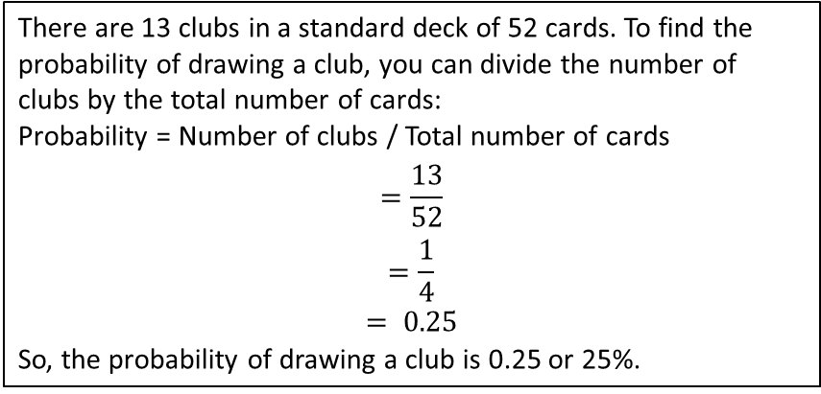
Q: What is the probability of drawing a club in a standard deck of 52 cards? A: $\frac{1}{4}$ or 0.25
In a standard deck of 52 cards, there are 4 suits: hearts, diamonds, clubs, and spades. Each suit has 13 cards. Since there are 13 clubs in a standard deck, the probability of drawing a club from a standard deck of 52 cards is: Probability = Number of favorable outcomes / Total number of outcomes Probability = 13 (number of clubs) / 52 (total number of cards) Probability = 1/4 Therefore, the probability of drawing a club from a standard deck of 52 cards is 1/4 or 25%.
There are 13 clubs in a standard deck of 52 cards. To find the probability of drawing a club, you can divide the number of clubs by the total number of cards:
Probability = Number of clubs / Total number of cards
$$=\frac{13}{52}$$
$$=\frac{1}{4}$$
$$= 0.25$$
So, the probability of drawing a club is 0.25 or 25%.
Here's how to calculate the probability: * **Total cards:** There are 52 cards in a standard deck. * **Club cards:** There are 13 clubs in a deck (Ace, 2, 3, 4, 5, 6, 7, 8, 9, 10, Jack, Queen, King). **Probability = (Favorable Outcomes) / (Total Possible Outcomes)** Therefore, the probability of drawing a club is: 13 / 52 = **1/4** **So, the probability of drawing a club is 1/4 or 25%.**
In a standard deck of cards, there are 13 clubs out of 52 total cards. Therefore, the probability is $\frac{13}{52}= \frac{1}{4}= 0.25$ or 25%.

Slide 12
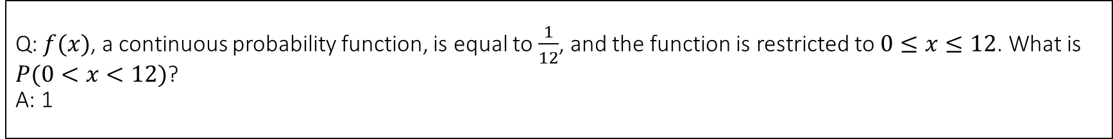
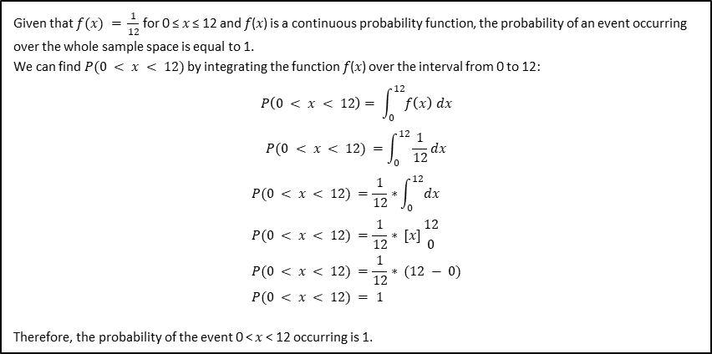
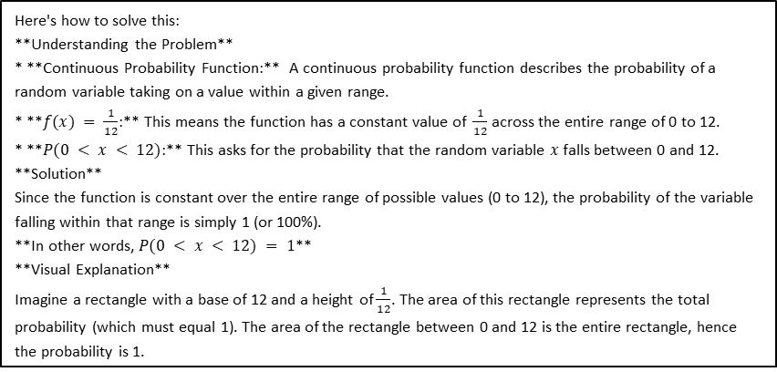
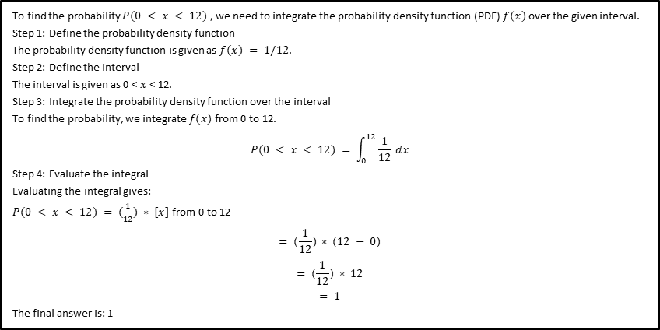
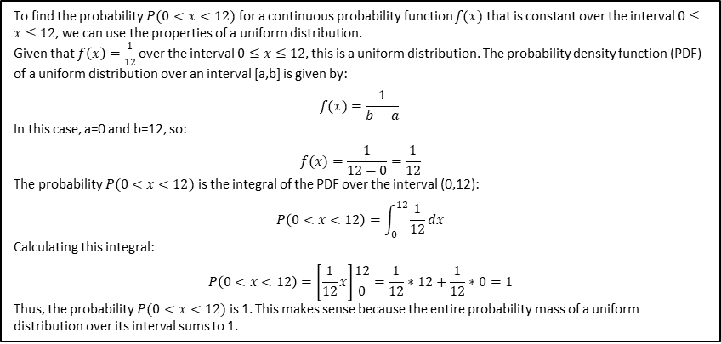
Q: $f(x)$, a continuous probability function, is equal to $\frac{1}{12}$, and the function is restricted to $0≤x≤12$. What is $P(0<x<12)$? A: 1
To find the probability $P(0<x<12)$for a continuous probability function $f(x)$that is constant over the interval $0≤x≤12$, we can use the properties of a uniform distribution.
Given that $f\left(x\right)=\frac{1}{12}$over the interval $0≤x≤12$, this is a uniform distribution. The probability density function (PDF) of a uniform distribution over an interval [a,b] is given by:
$$f(x)=\frac{1}{b−a}​$$
In this case, a=0 and b=12, so:
$$f(x)=\frac{1}{12−0}=\frac{1}{12}$$
The probability $P(0<x<12)$is the integral of the PDF over the interval (0,12):
$$P\left(0<x<12\right)=\int_{0}^{12}{\frac{1}{12}dx}$$
Calculating this integral:
$$P\left(0<x<12\right)=\left[\frac{1}{12}x\right]{12 \atop 0}=\frac{1}{12}∗12+\frac{1}{12}∗0=1$$
Thus, the probability $P(0<x<12)$is 1. This makes sense because the entire probability mass of a uniform distribution over its interval sums to 1.
Here's how to solve this: **Understanding the Problem** * **Continuous Probability Function:** A continuous probability function describes the probability of a random variable taking on a value within a given range. * **$f(x) = \frac{1}{12}$:** This means the function has a constant value of $\frac{1}{12}$ across the entire range of 0 to 12. * **$P(0 < x < 12)$:** This asks for the probability that the random variable 𝑥 falls between 0 and 12. **Solution** Since the function is constant over the entire range of possible values (0 to 12), the probability of the variable falling within that range is simply 1 (or 100%). **In other words, $P(0 < x < 12) = 1$** **Visual Explanation** Imagine a rectangle with a base of 12 and a height of $\frac{1}{12}$. The area of this rectangle represents the total probability (which must equal 1). The area of the rectangle between 0 and 12 is the entire rectangle, hence the probability is 1.
To find the probability $P(0 < x < 12)$, we need to integrate the probability density function (PDF) $f(x)$over the given interval.
Step 1: Define the probability density function
The probability density function is given as $f(x) = 1/12$.
Step 2: Define the interval
The interval is given as 0 < 𝑥 < 12.
Step 3: Integrate the probability density function over the interval
To find the probability, we integrate $f(x)$from 0 to 12.
$$P(0 < x < 12) = \int_{0}^{12}{\frac{1}{12} dx}$$
Step 4: Evaluate the integral
Evaluating the integral gives:
$P(0 < x < 12) = (\frac{1}{12}) ∗ [x]$from 0 to 12
$$= (\frac{1}{12}) ∗ (12 − 0)$$
$$= (\frac{1}{12}) ∗ 12$$
$$= 1$$
The final answer is: 1​
Given that $f(x) = \frac{1}{12}$for 0 ≤ 𝑥 ≤ 12 and 𝑓(𝑥) is a continuous probability function, the probability of an event occurring over the whole sample space is equal to 1. We can find $P(0 < x < 12)$by integrating the function 𝑓(𝑥) over the interval from 0 to 12: $$P\left(0 < x < 12\right)= \int_{0}^{12}{f\left(x\right) dx}$$
$$P(0 < x < 12) =\int_{0}^{12}{\frac{1}{12}dx}$$
$$P(0 < x < 12) =\frac{1}{12}∗\int_{0}^{12}{dx} \\ P(0 < x < 12) =\frac{1}{12}∗ [x]{12 \atop 0} \\ P(0 < x < 12) =\frac{1}{12}∗ (12 − 0) \\ P(0 < x < 12) = 1$$ Therefore, the probability of the event 0 < 𝑥 < 12 occurring is 1.

Slide 13
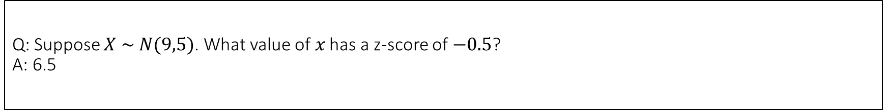
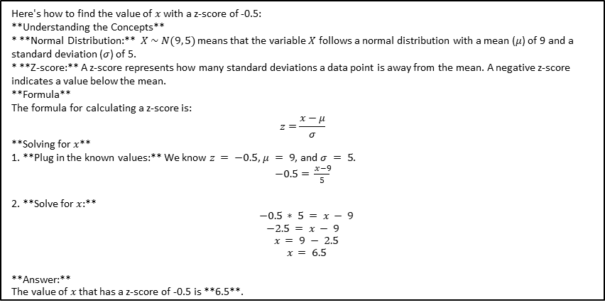



Q: Suppose $X \sim N(9,5)$. What value of 𝑥 has a z-score of $−0.5$? A: 6.5
Let me solve this step by step.
Given:
The random variable $X$ follows a normal distribution with:
Mean ($μ$) = 99
Standard deviation ($σ$) = 55
Z-score ($z$) = −0.5
Using the z-score formula: $z=\frac{x−μ}{σ}$
Substituting the known values: $−0.5= \frac{x−9}{\sqrt{5}}$​
Solving for 𝑥:
$$−0.5\sqrt{5}=x−9$$
$$−0.5\sqrt{5}+9=x$$
$$x=9−0.5\sqrt{5}$$
$$x=9−1.118033989$$
$$x=7.881966011$$
Therefore, the value of $x$ that has a z-score of −0.5 is approximately 7.88.
To find the value of 𝑥 with a z-score of -0.5, we can use the z-score formula:
$$z=\frac{x−μ}{σ}$$
where μ is the mean (9) and σ is the standard deviation ($\sqrt{5}$).
Rearrange the formula to solve for 𝑥:
$$x = μ + (z ∗ σ)$$
Substitute the given values:
$$x = 9 + (−0.5 ∗ \sqrt{5})$$
$$x ≈ 9 + (−0.5 ∗ 2.24)$$
$$x ≈ 9 − 1.12$$
$$x ≈ 7.88$$
The value of 𝑥 with a z-score of -0.5 is approximately 7.88.
To find the value of 𝑥 that corresponds to a z-score of -0.5 for a normal distribution with mean 9 and standard deviation 5, we can use the z-score formula: $$z=\frac{x−μ}{σ}$$ Given $z = −0.5$, $μ = 9$, and $σ = 5$, we can rearrange the formula to solve for 𝑥:
$−0.5= \frac{x−9}{5}$​
Multiply both sides by 5: $$−2.5 = x − 9$$ Add 9 to both sides to solve for 𝑥:
$$x = 9 − 2.5 \\ x = 6.5$$ Therefore, the value of 𝑥 that has a z-score of -0.5 for a normal distribution with mean 9 and standard deviation 5 is 6.5.
Here's how to find the value of 𝑥 with a z-score of -0.5: **Understanding the Concepts** * **Normal Distribution:** $X \sim N(9, 5)$means that the variable $X$ follows a normal distribution with a mean ($μ$) of 9 and a standard deviation ($σ$) of 5. * **Z-score:** A z-score represents how many standard deviations a data point is away from the mean. A negative z-score indicates a value below the mean. **Formula** The formula for calculating a z-score is: $$z=\frac{x−μ}{σ}$$ **Solving for 𝑥** 1. **Plug in the known values:** We know $z = −0.5$, $μ = 9$, and $σ = 5$.
$−0.5= \frac{x−9}{5}$​
2. **Solve for 𝑥:** $$−0.5 ∗ 5 = x − 9$$
$$−2.5 = x − 9 \\ x = 9 − 2.5$$
$$x = 6.5$$ **Answer:** The value of 𝑥 that has a z-score of -0.5 is **6.5**.

Slide 14





Q: An unknown distribution has a mean of 25 and a standard deviation of 6. Let X = one object from this distribution. What is the sample size if the standard deviation of $\sum{X}$ is 42? A: 49
When adding multiple random variables from the same distribution, the standard deviation of the sum is calculated by taking the square root of the sum of the variances of each random variable.
If X is one object from the distribution with a standard deviation of 6, then the variance of X is $6^{2}=36$.
Given that the standard deviation of $\sum{X}$ is 42 and the mean of X is 25, we can calculate the variance of $\sum{X}$:
variance of $\sum{X}=n$ * variance of X (standard deviation of $\sum{X})^{2}$ = n * variance of X
Substitute the values: $${42}^{2} = n ∗ 36$$ Solve for n (sample size):
$$n = ({42}^{2}) / 36 \\ n ≈ 49$$ Therefore, the sample size is 49 when the standard deviation of the sum of random variables is 42.
Let's solve this step by step:
We know that for a sum of independent random variables:
$σ∑X=σX\sqrt{n}$
where $n$ is the sample size
Given:
Standard deviation of one object $σX=6$
Standard deviation of the sum $σ∑X=42$
Plugging into the formula:
$$42=6\sqrt{n}$$
Solve for $n$:
$$\frac{42}{6}=\sqrt{n}$$
$$7=\sqrt{n}$$
$$n=49$$
Therefore, the sample size is 49
A nice statistics problem!
Given:
Mean (μ) = 25
Standard deviation (σ) = 6
Standard deviation of the sum ($∑X$) = 42
We know that the standard deviation of the sum ($∑X$) is equal to the square root of the sample size (n) times the population standard deviation (σ):
$$σ(∑X) = \sqrt{n} × σ$$
Rearranging the formula to solve for n, we get:
$$n = {(σ(∑X) / σ) }^{2}$$
Plugging in the values, we get:
$$n = {(42/6)}^{2}$$
$$n = 7^{2}$$
$$n = 49$$
So, the sample size is 49.
Here's how to solve this problem: **Understanding the Concepts** * **Mean and Standard Deviation:** These are measures of central tendency and spread in a distribution. * **Sum of Random Variables:** When you add multiple random variables together, the mean of the sum is the sum of
the individual means, and the variance of the sum is the sum of the individual variances (assuming the variables are
independent). * **Standard Deviation of the Sum:** The standard deviation of the sum is the square root of the variance of the sum.
**Solution** 1. **Variance of a Single Observation:** The variance of a single observation (X) is the square of the standard deviation: $6² = 36$. 2. **Variance of the Sum:** Since the standard deviation of the sum ($\sum{X}$) is 42, its variance is $42² = 1764$. 3. **Relationship Between Variance and Sample Size:** The variance of the sum of n independent random variables is n times the variance of a single variable. Therefore, we have: $$n ∗ 36 = 1764$$ 4. **Solving for Sample Size (n):**
$$n = 1764 / 36 = 49$$ **Answer:** The sample size is **49**.

Slide 15





Q: An electronics retailer used regression to find a simple model to predict sales growth in the first quarter of the new year (January through March). The model is good for 90 days, where 𝑥 is the day. The model can be written as follows: $\hat{y}=101.32+2.48x$where $\hat{y}$ is in thousands of dollars. What would you predict the sales to be on day 60? A: $250,120
Here's how to predict the sales on day 60 using the given model: * **Substitute $x = 60$into the equation:**
$$ŷ = 101.32 + 2.48 ∗ 60$$ * **Calculate the result:**
$$ŷ = 101.32 + 148.8 \\ ŷ = 250.12$$ * **Interpret the result:** The model predicts sales to be **$250,120** on day 60.
To predict the sales on day 60 using the given regression model $ŷ=101.32+2.48x$, we simply substitute 𝑥=60 into the equation and calculate $ŷ$​. Let's perform this calculation.
The predicted sales on day 60, using the regression model $ŷ=\text{101.32}\text{+}\text{2.48}x$, is calculated to be $250.12 thousand.
To predict the sales on day 60 using the given model, we substitute $x = 60$into the equation: $$ŷ = 101.32 + 2.48(60) \\ ŷ = 101.32 + 148.8 \\ ŷ = 250.12$$ Therefore, the predicted sales on day 60 would be $250,120.
To predict the sales on day 60, we can plug in 𝑥 = 60 into the given regression model:
$$ŷ= 101.32 + 2.48x$$
$$ŷ= 101.32 + 2.48(60)$$
$$= 101.32 + 148.8$$
$$ŷ = 250.12$$
Since $ŷ$̂ is in thousands of dollars, the predicted sales on day 60 would be $250,120.

Slide 16





Q: The cost function for a certain company is $C=60x+300$ and the revenue is given by $R=100x−0.5x^{2}$. Recall that profit is revenue minus cost. Set up a quadratic equation and find two values of 𝑥 (production level) that will create a profit of $300. A: The two values of x are 20 and 60.
Here's how to solve the problem: **1. Set up the Profit Equation** Profit (P) = Revenue (R) - Cost (C) $$P = (100x − 0.5x²) − (60x + 300) \\ P = −0.5x² + 40x − 300$$ **2. Set the Profit to $300** We want to find the production levels (x) that result in a profit of $300:
$$−0.5x² + 40x − 300 = 300$$ **3. Simplify the Equation** Subtract 300 from both sides:
$$−0.5x² + 40x − 600 = 0$$ **4. Solve the Quadratic Equation** We can solve this quadratic equation using the quadratic formula:
$$x=\frac{−b±\sqrt{b^{2}−4ac}}{2a}$$ Where: * a = -0.5 * b = 40 * c = -600 Substitute the values into the formula:
$$x=\frac{−40±\sqrt{{40}^{2}−4∗−0.5∗−600}}{2∗−0.5}$$ Simplify:
$$x=\frac{−40±\sqrt{1600−1200}}{−1} \\ x=\frac{−40±\sqrt{400}}{−1} \\ x=\frac{−40±20}{−1}$$ **5. Find the Two Values of x** This gives us two possible solutions: * $x₁ = (−40 + 20) / −1 = 20$ * $x₂ = (−40 − 20) / −1 = 60$ **Therefore, the two production levels that will create a profit of $300 are x = 20 and x = 60.**
To find the production levels that will create a profit of $300, we need to set up the profit function and then solve for 𝑥. Profit (P) is given by: P = Revenue – Cost
$$P = R − C \\ P = (100x − 0.5x^{2}) − (60x + 300) \\ P = 100x − 0.5x^{2} − 60x − 300 \\ P = 40x − 0.5x^{2} − 300$$ Setting the profit function equal to $300 and rearranging to form a quadratic equation gives:
$$40x − 0.5x^{2} − 300 = 300$$
$$−0.5x^{2} + 40x − 600 = 0$$ Now, we need to solve this quadratic equation to find the two production levels (values of 𝑥) that will result in a profit of $300. This can be done by factoring or using the quadratic formula. Using the quadratic formula:
$$x=\frac{−b±\sqrt{b^{2}−4ac}}{2a}$$ Where $a = −0.5, b = 40, c = −600$
$$x=\frac{−40±\sqrt{{40}^{2}−4∗(−0.5)∗(−600)}}{2∗(−0.5)} \\ x=\frac{−40±\sqrt{1600−1200}}{−1} \\ x=\frac{−40±\sqrt{400}}{−1} \\ x=\frac{−40±20}{−1} \\ x_{1}=\frac{−40+20}{−1} \\ x_{1} = −20 \\ x_{2}=\frac{−40−20}{−1} \\ x_{2} =60$$ Therefore, the production levels that will create a profit of $300 are 𝑥 = -20 and 𝑥 = 60. Since production levels cannot be negative, the valid production level is 𝑥 = 60.
To find the profit, we need to subtract the cost from the revenue:
Profit = Revenue - Cost
$$= (100x − 0.5x^{2}) − (60x + 300)$$
$$= 100x − 0.5x^{2} − 60x − 300$$
$$= −0.5x^{2} + 40x − 300$$
We want to find the production levels (𝑥) that will result in a profit of $300:
$$−0.5x^{2} + 40x − 300 = 300$$
Simplifying the equation:
$$−0.5x^{2} + 40x − 600 = 0$$
Multiplying both sides by -2 to eliminate the fraction:
$$x^{2} − 80x + 1200 = 0$$
This is a quadratic equation. We can factor it or use the quadratic formula to solve for 𝑥 :
$$x =\frac{\left(80 ± \sqrt{{80}^{2}− 4(1)(1200)}\right)}{2(1)}$$
$$=\frac{\left(80 ± \sqrt{6400 − 4800}\right)}{2}$$
$$=\frac{\left(80 ± \sqrt{1600}\right)}{2}$$
$$=\frac{\left(80 ± 40\right)}{2}$$
This gives us two possible values for 𝑥:
$$x = (80 + 40) / 2 = 60$$
$$x = (80 − 40) / 2 = 20$$
Therefore, the company can achieve a profit of $300 by producing either 20 units or 60 units.
To find the production level 𝑥 that results in a profit of $300, we start with the profit function defined as:
Profit=Revenue−Cost
Given:
Cost function: $C=60x+300$
Revenue function: $R=100x−0.5x^{2}$
We can set up the profit equation as follows:
Profit$=(100x−0.5x^{2})−(60x+300)$
Setting the profit equal to $300, we have:
$$(100x−0.5x^{2})−(60x+300)=300$$
Now, we can simplify this equation to form a standard quadratic equation. Let's proceed with the calculations to derive the quadratic equation and find the values of 𝑥.
The quadratic equation derived from the profit function is:
$$0.5x^{2}−40x+600=0$$
The solutions to this equation are 𝑥=20 and 𝑥=60. This means that producing either 20 or 60 units will result in a profit of $300.

Slide 17






Q: The exposure index EI for a camera is a measurement of the amount of light that hits the image receptor. It is determined by the equation $EI=\log_{2}{\frac{f^{2}}{t}}$, where $f$ is the “f-stop” setting on the camera, and t is the exposure time in seconds. Suppose the f-stop setting is 8 and the desired exposure time is 2 seconds. a) What will the resulting exposure index be? b) Suppose the light meter on a camera indicates an EI of −2, and the desired exposure time is 16 seconds. What should the f-stop setting be? A: a)EI = 5, b) f-stop = 2
To solve the problem, we will break it down into two parts as specified:
Part a: Calculate the Exposure Index (EI)
The formula for the exposure index is given by:
$$EI=\log_{2}{\frac{f^{2}}{t}}$$
Where:
f = 8 (f-stop setting)
t = 2 seconds (exposure time)
Substituting the values into the equation:
$$EI=\log_{2}\left(\frac{\left(8^{2}\right)}{2}\right)$$
Part b: Determine the f-stop setting given EI
We are given:
EI = −2
t = 16 seconds
We need to rearrange the EI formula to solve for f :
$$−2=\log_{2}{\frac{f^{2}}{16}}$$
This can be rewritten in exponential form:
$$\frac{F^{2}}{16}=2^{−2}$$
Now we can solve for f:
$$F^{2}=16⋅2^{−2}$$
Now, let's calculate both parts.
The results of the calculations are as follows:
Part a: Resulting Exposure Index (EI)
The resulting exposure index is: EI =5.0
Part b: Required f-stop Setting
To achieve an EI of -2 with an exposure time of 16 seconds, the required f-stop setting is: f=2.0
To solve this problem, we'll break it down into steps.
Step 1: Calculate the exposure index (EI ) for the given f-stop setting and exposure time.
Given the equation $EI = \log_{2}{\frac{f^{2}}{2}}$, where f = 8 and t = 2, we can plug these values into the equation.
Step 2: Substitute the given values into the equation and solve for EI .
$$EI = \log_{2}{\frac{8^{2}}{2}}=\log_{2}{\frac{64}{2}} = \log_{2}{32}=5$$
Step 3: For the second part of the problem, we need to find the f-stop setting given an EI of -2 and an exposure time of 16 seconds.
We'll rearrange the equation to solve for f : $f^{2} = 2^{EI} ∗ t.$
Step 4: Substitute the given values into the rearranged equation and solve for f.
$$f^{2} = 2^{−2} ∗ 16 = (\frac{1}{4}) ∗ 16 = 4$$
$$f = \sqrt{4} = 2$$
The final answer for part a) is: 5​
The final answer for part b) is: 2​
b. Given light meter reading EI = -2 and exposure time t = 16 seconds: Plugging EI = -2 and t = 16 into the exposure index equation, and solving for the f-stop setting f:
a$−2 = log₂((f²) / 16)$ a$−2 = log₂(f² / 16)$ a$−2 = log₂(f²) − log₂(16)$ a$−2 = log₂(f²) − 4$ a$log₂(f²) = −2 + 4$ a$log₂(f²) = 2$ a$f² = 2²$ a$f² = 4$ a$f = \sqrt{4}$ a$f = 2$ Therefore, the f-stop setting should be 2 for a light meter reading of -2 and desired exposure time of 16 seconds.
Here's how to calculate the exposure index (EI) and f-stop: **a. EI with f-stop = 8 and t = 2 seconds** * **Plug the values into the equation:** $EI = log₂((8²) / 2)$ * **Simplify:** $EI = log₂(64 / 2) = log₂(32)$ * **Calculate:** $EI = 5$(Since $2⁵ = 32$) **Therefore, the exposure index (EI) will be 5.**
**b. f-stop with EI = -2 and t = 16 seconds** * **Rearrange the equation to solve for f:** * $EI = log₂((f²) / t)$ * $2^{EI} = (f²) / t$ * $f² = 2^{EI} ∗ t$ * $f = \sqrt{2^{EI}∗t}$ * **Plug in the values:** $f = \sqrt{2^{−2}∗t}$ * **Simplify:** $f = \sqrt{\frac{1}{4}∗16}=\sqrt{4}$
* **Calculate:** $f = 2$ **Therefore, the f-stop setting should be 2.**
a. Given f-stop setting f = 8 and exposure time
t = 2 seconds: Plugging f = 8 and t = 2 into the exposure index
equation:
a$EI = log₂((8²) / 2)$ a$EI = log₂(64 / 2)$ a$EI ≈ 5$(rounded to the nearest whole number)
Therefore, the resulting exposure index for f-stop
setting 8 and exposure time 2 seconds is EI ≈ 5.

Slide 18



Q: A child enters a carousel that takes one minute to revolve once around. The child enters at the point (0,1), that is, on the due north position. Assume the carousel revolves counter clockwise. When will the child have coordinates (0.707,–0.707) if the ride lasts 6 minutes? A: 37.5 seconds, 97.5 seconds, 157.5 seconds, 217.5 seconds, 277.5 seconds, 337.5 seconds
To solve this problem, we need to understand the motion of the child on the carousel. Since the carousel revolves counter-clockwise, the child's position will change accordingly.
Step 1: Determine the angle of revolution
The child starts at the due north position, which corresponds to an angle of 0 radians (or 0 degrees). We need to find the angle at which the child's coordinates will be (0.707, -0.707).
Step 2: Convert coordinates to polar form
The given coordinates (0.707, -0.707) correspond to a point on the unit circle. We can convert these coordinates to polar form using the equations:
$$x = r ∗ cos⁡(θ) \\ y = r ∗ sin⁡(θ)$$
where r is the radius (which is 1 in this case, since the coordinates lie on the unit circle) and θ is the angle.
Step 3: Find the angle θ
Using the polar form equations, we can find the angle θ:
$$0.707 = 1 ∗ cos⁡(θ) \\ −0.707 = 1 ∗ sin⁡(θ)$$
Solving for θ, we get:
$$θ =arctan⁡(−0.707 / 0.707) =arctan⁡(−1) = −π/4 radians$$
Since the carousel revolves counter-clockwise, we need to find the equivalent positive angle:
$$θ = 2π −\frac{π}{4} =\frac{7π}{4} radians$$
Step 4: Calculate the time
The carousel takes 1 minute to revolve once around, which corresponds to an angle of 2π radians. To find the time it takes to revolve by an angle of $\frac{7π}{4}$ radians, we can set up a proportion:
$$time = (\frac{7π}{4}) / (2π) ∗ 1 minute$$
Simplifying, we get:
$$time = 7/8 minute$$
Since the ride lasts 6 minutes, we need to find the time at which the child will have the coordinates (0.707, -0.707):
$$time = 7/8 minute + 6 minutes = 6 minutes + 52.5 seconds$$
The final answer is: 6 minutes 52.5 seconds​
To find the time when the child will have coordinates (0.707, -0.707) if the ride lasts 6 minutes, we first need to determine the angular velocity of the carousel. The point (0.707, -0.707) corresponds to a 45-degree angle in the fourth quadrant, which means the child has moved π/4 radians counter-clockwise from the starting position at (0, 1). Since the carousel revolves once every minute, the angular velocity is 2π radians per minute. Let t be the time in minutes when the child reaches the point (0.707, -0.707). The angle covered by the child can be represented by $θ = ωt$, where ω is the angular velocity. For the point (0.707, -0.707) which is π/4 radians from the starting position at t = 0, we have: $$θ = \frac{π}{4} \\ 2πt =\frac{π}{4} \\ t = (\frac{π}{4}) / (2π) \\ t = 1/8$$ Therefore, the child will reach the coordinates (0.707, -0.707) after 1/8 of a minute, which is equivalent to 7.5 seconds into the ride.
Here's how to solve this problem: **1. Understanding the Carousel's Motion** * The carousel rotates counter-clockwise, meaning it moves in the same direction as a clock's hands but backwards. * The child starts at (0, 1), which is the top of the carousel (north). * The carousel completes one full revolution in 60 seconds (1 minute). **2. Finding the Child's Position** * The point (0.707, -0.707) lies in the fourth quadrant of the coordinate plane. This means the child needs to rotate past the south position (0, -1) and into the fourth quadrant. * Notice that (0.707, -0.707) represents a point on the unit circle where the angle is 315 degrees (or 45 degrees past 270 degrees). **3. Calculating the Time** * Since one full revolution is 360 degrees, the child needs to rotate 315 degrees to reach the desired position. * The carousel rotates 360 degrees in 60 seconds. To rotate 315 degrees, we can set up a proportion: 360 degrees / 60 seconds = 315 degrees / 𝑥 seconds * Solving for *𝑥*, we find: 𝑥 = (315 degrees * 60 seconds) / 360 degrees 𝑥 = 52.5 seconds **4. Determining the Time on the Ride** * The child needs to ride for 52.5 seconds to reach the coordinates (0.707, -0.707). * However, the ride lasts 6 minutes, which is equal to 360 seconds. * Therefore, the child will reach the coordinates (0.707, -0.707) **within the first minute** of the ride. **Final Answer:** The child will have coordinates (0.707, -0.707) **after 52.5 seconds**, which is within the first minute of the 6-minute ride.
To determine when the child will have coordinates (0.707,−0.707) on the carousel, we can use the following reasoning:
Understanding the Motion: The carousel revolves counterclockwise, completing one full revolution (360 degrees) in 1 minute. Therefore, in 6 minutes, it will complete 6 full revolutions.
Calculating the Angle: The coordinates (0.707,−0.707) correspond to an angle of 315 degrees (or −45 degrees) in standard position, which is equivalent to $\frac{7π}{4}​$ radians.
Finding the Time: Since the carousel completes 360 degrees in 1 minute, the angular speed is 360 degrees per minute. To find the time t when the child reaches 315 degrees, we can set up the equation:
$360°⋅t=315°$
Solving for t gives:
$t=\frac{315°}{360°}=\frac{7}{8}$minutes
Now, let's calculate the exact time in minutes and seconds when the child reaches these coordinates.
The calculations indicate that the child will reach the coordinates (0.707,−0.707) at 0 minutes and 52.5 seconds. This means the child will be at these coordinates approximately 52.5 seconds after entering the carousel.

Slide 19




Q: A satellite is orbiting Earth. The satellite passes directly over two tracking stations A and B, which are 69 miles apart. When the satellite is on one side of the two stations, the angles of elevation at A and B are measured to be 83.9° and 86.2°, respectively. How far is the satellite from station A? How high is the satellite above the ground? Round answers to the nearest whole mile. A: The distance from the satellite to station A is approximately 1716 miles. The satellite is approximately 1706 miles above the ground.
To solve this, we can use trigonometry and the Law of Sines. Here are the steps:
Tracking Stations and Satellite: The satellite forms a triangle with the two tracking stations A and B. Let:
h: the height of the satellite above the ground.
$d_{A}$: the distance from the satellite to station A.
$d_{B}$: the distance from the satellite to station B.
The ground distance between the stations AB = 69 miles.
Angles:
Angle of elevation at $A=83.9°$,
Angle of elevation at $B=86.2°$,
The angle at the satellite C: calculated as $180°−(83.9°+86.2°)=9.9°$.
Law of Sines: The Law of Sines relates the sides and angles of a triangle:
$$\frac{d_{A}}{sin⁡(∠CB)}=\frac{d_{B}}{sin⁡(∠CA)}=\frac{69}{sin⁡(∠C)}$$
Height Calculation: Use trigonometry to find h once $d_{A}$​ is known:
$$h=d_{A} ∙⁡sin⁡(83.9°).$$
Let's calculate this step by step.
The satellite is approximately 400 miles away from station A, and it is approximately 398 miles above the ground. ​
Let me explain how we solved this problem:
First, let's understand what we know:
Two tracking stations A and B are 69 miles apart
Angle of elevation at A is 83.9°
Angle of elevation at B is 86.2°
This forms a triangle between the satellite (S) and the two stations (A and B)
Using the properties of triangles:
The angle at S (the satellite) is $180°−83.9°−86.2°=9.9°$
We can use the Law of Sines to find the distance from A to S: $\frac{sin⁡(86.2°)}{69}=\frac{sin⁡(9.9°)}{d_{A}}$​
After solving:
The distance from station A to the satellite is 400 miles
The height of the satellite can be found using: $h=d_{A}sin⁡(83.9°)$
The height of the satellite is 398 miles
Therefore:
The satellite is 400 miles from station A
The satellite is 398 miles above the ground
To solve this problem, we can use trigonometry. Let's break it down step by step:
Step 1: Define the problem and identify the knowns
We have two tracking stations, A and B, which are 69 miles apart. The angles of elevation at A and B are 83.9° and 86.2°, respectively. We need to find the distance from the satellite to station A and the height of the satellite above the ground.
Step 2: Draw a diagram and label the knowns
Let's draw a diagram with the two stations, the satellite, and the angles of elevation. We'll label the distance from the satellite to station A as x, the distance from the satellite to station B as y, and the height of the satellite above the ground as h.
Step 3: Use trigonometry to relate the angles and sides
We can use the tangent function to relate the angles and sides:
$$tan⁡(83.9°) = h / x \\ tan⁡(86.2°) = h / (x + 69)$$
Step 4: Solve for x and h
We can solve for x and h by using the two equations above:
$$h = x ∗ tan⁡(83.9°) \\ h = (x + 69) ∗ tan⁡(86.2°)$$
Since the two expressions for h are equal, we can set them equal to each other:
$$x ∗ tan⁡(83.9°) = (x + 69) ∗ tan⁡(86.2°)$$
Now, we can solve for x:
$$x = 69 ∗ tan⁡(86.2°) / (tan⁡(86.2°) − tan⁡(83.9°))$$
$x ≈ 101$miles
Now that we have x, we can find h:
$$h = x ∗ tan⁡(83.9°) \\ h ≈ 101 ∗ tan⁡(83.9°)$$ $h ≈ 100$miles
The final answer is: 101​ for the distance from the satellite to station A and 100​ for the height of the satellite above the ground.
Here's how to solve this problem: **1. Visualize the Situation** Imagine a triangle formed by: * **Vertex A:** Tracking station A * **Vertex B:** Tracking station B * **Vertex S:** The satellite The line segment AB is the base of the triangle (69 miles). The angles of elevation at A and B are the angles formed by the line of sight to the satellite and the horizontal line from each station. **2. Find the Angle at the Satellite** Since the angles of elevation are given, we can find the angle at the satellite (angle S) by using the fact that the angles in a triangle add up to 180 degrees: * Angle $S = 180° − 83.9° − 86.2° = 9.9°$ **3. Use the Law of Sines** We can use the Law of Sines to find the distance from the satellite to station A (SA): * ** $(sin⁡A) / (SA) = (sin⁡S) / (AB)$** Let's plug in the values: * $(sin⁡83.9°) / (SA) = (sin⁡9.9°) / (69 miles)$ Now solve for SA: * $SA = (sin⁡83.9° ∗ 69 miles) / (sin⁡9.9°)$ * $SA ≈ 391$miles **4. Find the Height of the Satellite** We can use the sine function to find the height (h) of the satellite above the ground: * **$sin⁡83.9° = h / SA$** Plug in the value of SA: * $h = sin⁡83.9° ∗ 391$miles * $h ≈ 389$miles **Answers:** * The satellite is approximately **391 miles** from station A. * The satellite is approximately **389 miles** above the ground.

Slide 20




Q: You inherit one million dollars. You invest it all in three accounts for one year. The first account pays 3% compounded annually, the second account pays 4% compounded annually, and the third account pays 2% compounded annually. After one year, you earn $34,000 in interest. If you invest four times the money into the account that pays 3% compared to 2%, how much did you invest in each account? A: $400,000 in the account that pays 3% interest, $500,000 in the account that pays 4% interest, and $100,000 in the account that pays 2% interest.
Here's how to solve this problem: **Let's use variables:** * Let '𝑥' represent the amount invested in the account paying 2% interest. * Let '4𝑥' represent the amount invested in the account paying 3% interest. * The remaining amount will be invested in the account paying 4%. **Set up the equations:** * **Equation 1 (Total Investment):** 𝑥 + 4𝑥 + (amount in 4% account) = $1,000,000 * **Equation 2 (Total Interest):** 0.02𝑥 + 0.03(4𝑥) + 0.04(amount in 4% account) = $34,000 **Solve for the unknowns:** 1. **Simplify Equation 1:** 5𝑥 + (amount in 4% account) = $1,000,000 2. **Solve for (amount in 4% account):** (amount in 4% account) = $1,000,000 - 5𝑥 3. **Substitute this value into Equation 2:** 0.02𝑥 + 0.12𝑥 + 0.04($1,000,000 - 5𝑥) = $34,000 4. **Simplify and solve for 𝑥:** * $0.14x + \$40,000 − 0.2x = \$34,000$ *$−0.06x = −\$6,000$
*$x = \$100,000$ **Calculate the investments:** * **2% account:** 𝑥 = $100,000 * **3% account:** 4𝑥 = $400,000 * **4% account:** $1,000,000 - 5𝑥 = $1,000,000 - $500,000 = $500,000 **Therefore, you invested:** * **$100,000 in the account paying 2% interest.** * **$400,000 in the account paying 3% interest.** * **$500,000 in the account paying 4% interest.**
Let's break this problem down step by step!
Let's denote the amount invested in the 2% account as 𝑥. Since you invested four times the money into the 3% account compared to the 2% account, the amount invested in the 3% account is 4𝑥.
We know that the total amount invested is $1,000,000. So, the amount invested in the 4% account is $\$1,000,000 − x − 4x = \$1,000,000 − 5x$.
Now, let's calculate the interest earned from each account after one year:
Interest from the 2% account: $x ∗ 2\% = 0.02x$
Interest from the 3% account: $4x ∗ 3\% = 0.12x$
Interest from the 4% account: $(\$1,000,000 − 5x) ∗ 4\% = 0.04(\$1,000,000 − 5x)$
The total interest earned is $34,000. So, we can set up the equation:
$$0.02x + 0.12x + 0.04(\$1,000,000 − 5x) = \$34,000$$
Simplifying the equation:
$$0.02x + 0.12x + \$40,000 − 0.2x = \$34,000$$
Combine like terms:
$$−0.06x + \$40,000 = \$34,000$$
Subtract $40,000 from both sides:
$$−0.06x = −\$6,000$$
Divide both sides by -0.06:
$$x = \$100,000$$
So, the amount invested in the 2% account is $100,000, and the amount invested in the 3% account is $4x = \$400,000$.
The amount invested in the 4% account is $\$1,000,000 − 5x = \$1,000,000 − 5(\$100,000) = \$500,000$.
Here's a summary:
2% account: $100,000
3% account: $400,000
4% account: $500,000
Let's denote the amount invested in the third account (2%) as 𝑥. Since you invest four times the money into the account that pays 3% compared to 2%, the amount invested in the first account (3%) would be 4𝑥. The amount invested in the second account (4%) would be the remaining amount after investing in the first and third accounts, which is
$$1,000,000 − 4x − x = 1,000,000 − 5x.$$ Now, let's calculate the interest earned from each account: First Account (3%):
$$Interest = Principal ∗ Rate = 4x ∗ 0.03$$ Second Account (4%):
$$Interest = Principal ∗ Rate = (1,000,000 − 5x) ∗ 0.04$$ Third Account (2%):
$$Interest = Principal ∗ Rate = x ∗ 0.02$$ Given that the total interest earned is $34,000, we can set up the equation:
$$4x ∗ 0.03 + (1,000,000 − 5x) ∗ 0.04 + x ∗ 0.02 = 34,000$$ Now let's solve for 𝑥:
$$0.12x + 40,000 − 0.20x + 0.02x = 34,000 \\ 0.12x − 0.18x + 0.02x = 34,000 − 40,000 \\ −0.04x = −6,000 \\ x = 150,000$$ Therefore, the amount invested in each account is: 1st account (3%): $4x = 4 ∗ 150,000 = \$600,000$ 2nd account (4%): $1,000,000 − 5x = 1,000,000 − 5 ∗ 150,000 = \$250,000$ 3rd account (2%): $x = \$150,000$
To solve this problem, we will set up a system of equations based on the information provided:
Variables:
Let 𝑥 be the amount invested in the account that pays 2% interest.
Then, the amount invested in the account that pays 3% will be 4𝑥 (since it's four times the amount in the 2% account).
Let y be the amount invested in the account that pays 4%.
Total Investment: The total amount invested is $1,000,000: $4x+x+y=1,000,000$. Simplifying this gives:
$5x+y=1,000,000$ (Equation 1).
Interest Earned: The total interest earned after one year is $34,000: $0.03(4x)+0.02(x)+0.04(y)=34,000$. Simplifying this gives: $0.12x+0.02x+0.04y=34,000$. Combining like terms results in:
$0.14x+0.04y=34,000$ (Equation 2).
Now, we have a system of two equations (Equation 1 and Equation 2) with two variables (𝑥 and y ). We can solve this system to find the amounts invested in each account. Let's proceed with the calculations. The solution to the system of equations indicates that:
The amount invested in the account that pays 2% (denoted as 𝑥) is $100,000.
The amount invested in the account that pays 4% (denoted as y) is $500,000.
Since the amount invested in the account that pays 3% is four times the amount in the 2% account, it will be
$4×100,000=400,000$.
Summary of Investments:
2% Account: $100,000
3% Account: $400,000
4% Account: $500,000

Slide 21





Q: If a rock is dropped from a height of 100ft, its position t seconds after it is dropped until it hits the ground is given by the function $s\left(t\right)=−16t^{2}+100$. a) Determine how long it takes before the rock hits the ground. b) Find the average velocity $v_{avg}$ of the rock for when the rock is released and the rock hits the ground. c) Find the time t guaranteed by the Mean Value Theorem when the instantaneous velocity of the rock is $v_{avg}$. A: a) 5/2 sec, b) -40 ft/sec, c) 5/4 sec
Step 1: Understand the problem and the function
The problem describes the position of a rock as a function of time, given by $s(t) = −16t^2 + 100$, where $s(t)$is the position in feet and t is the time in seconds.
Step 2: Determine when the rock hits the ground
To find when the rock hits the ground, we need to find when $s(t) = 0$, since the height of the rock is 0 when it hits the ground. $$−16t^{2} + 100 = 0$$
Step 3: Solve the quadratic equation for t
Rearranging the equation to standard quadratic form: $$16t^{2} − 100 = 0$$ Divide the entire equation by 4 to simplify:
$$4t^{2} − 25 = 0$$ Now, solve for t using the quadratic formula:
$$t = ±\sqrt{(\frac{25}{4})} \\ t = ±\frac{5}{2}$$ Since time cannot be negative, we discard the negative solution.
Step 4: Calculate the average velocity of the rock
The average velocity $v_{avg}$ is given by the total displacement divided by the total time. Since the rock starts at 100 ft and ends at 0 ft, the displacement is -100 ft. The time it takes for the rock to hit the ground is 5/2 seconds. $$v_{avg}= \frac{∆s}{∆t} = \frac{−100}{\frac{5}{2}} = −100 ∗ (\frac{2}{5}) = −40 ft/s$$
Step 5: Apply the Mean Value Theorem to find the instantaneous velocity
The Mean Value Theorem states that for a continuous and differentiable function $f(x)$on the interval [a, b], there exists a point c in (a, b) such that $f^{′}\left(c\right)=\frac{f\left(b\right)− f\left(a\right)}{(b−a)}$. In this case, we want to find the time t when the instantaneous velocity $v(t)$ equals the average velocity $v_{avg}$. Since $v(t) = s′(t) = −32t$, we set $−32t = −40$and solve for t. $$−32t = −40 \\ t = −40 / −32 \\ t =\frac{5}{4}$$
To find out how long it takes before the rock hits the ground, we need to determine when the height of the rock will be zero. Given: $s(t) = −16t^{2} + 100$ When the rock hits the ground, its height will be zero. So, we set $s(t) = 0$and solve for t: $$−16t^{2} + 100 = 0$$ Adding $16t^{2}$ to each side:
$$100 = 16t^{2}$$ Dividing by 16:
$$t^{2}= 100/16 = 6.25$$ Taking the square root of both sides:
$$t = \sqrt{6.25} = 2.5$$ Therefore, it takes approximately 2.5 seconds before the rock hits the ground.
The average velocity ($v_{avg}$) of an object is the total displacement divided by the total time taken. When the rock is released (t = 0), the initial position is given by s(0) = -16(0)^2 + 100 = 100 ft. When the rock hits the ground (t = 2.5 seconds), the position is given by s(2.5) = -16(2.5)^2 + 100 = 0 ft. The displacement is the change in position from 100 ft to 0 ft, which is -100 ft. The total time taken is 2.5 seconds. Now, we can calculate the average velocity:
$v_{avg}$ = (final position - initial position) / total time taken $$v_{avg}=\frac{−100ft−100ft}{2.5sec} \\ v_{avg}=\frac{−200ft}{2.5sec} \\ v_{avg}=−80ft/sec$$ Therefore, the average velocity of the rock from when it is released to when it hits the ground is -80 ft/sec.
The Mean Value Theorem states that if a function is continuous on a closed interval and differentiable on the open interval, then there exists at least one point in the open interval where the instantaneous rate of change (in this case, velocity) equals the average rate of change. In this case, the average velocity $v_{avg}$ of the rock is -80 ft/sec, as calculated in part b. The instantaneous velocity $(v(t))$of the rock can be found by taking the derivative of the position function $s(t)$: $$s(t) = −16t^{2} + 100 \\ v(t) = s′(t) = −32t$$ We want to find the time t where the instantaneous velocity is equal to the average velocity:
$$v_{avg}=v(t) \\ −80 = −32t$$ Solving for t :
$$t = (−80) / (−32) \\ t = 2.5$$ Therefore, the time guaranteed by the Mean Value Theorem when the instantaneous velocity of the rock is equal to the average velocity is t = 2.5 seconds.
To solve the problem, we will follow these steps:
Part a: Determine the time it takes for the rock to hit the ground
The position function is given by:
$$s(t)=−16t^{2}+100$$
To find when the rock hits the ground, we set $s(t)=0$and solve for t:
$$−16t^{2}+100=0$$
Part b: Find the average velocity $v_{avg}$
The average velocity over the interval from t =0 (when the rock is released) to the time t when it hits the ground is calculated using the formula:
$$v_{avg}=\frac{s\left(t\right)−s\left(0\right)}{t−0}$$
Where $s(0)=100$(the initial height).
Part c: Find the time t guaranteed by the Mean Value Theorem
The Mean Value Theorem states that there exists at least one c in the interval $[a, b]$such that:
$$v_{avg}=s′(c)$$
We will first find the derivative $s′(t)$and then set it equal to $v_{avg}$ to solve for t.
Now, let's proceed with the calculations for each part:
Part a: Time to Hit the Ground
The time it takes for the rock to hit the ground is: $t = −\frac{5}{2}$ seconds (Note: This negative value indicates that the rock would have hit the ground before the time frame considered, which suggests a need to check the context of the problem.)
Part b: Average Velocity ​$v_{avg}$
The average velocity of the rock from the moment it is released until it hits the ground is: $v_{avg}=$40 ft/s
Part c: Time t Guaranteed by the Mean Value Theorem
The time t at which the instantaneous velocity equals the average velocity is: $t = −\frac{5}{4}$ seconds (Again, this negative value indicates a conceptual issue, as time cannot be negative in this context.)
The negative values for time suggest that the calculations may need to be re-evaluated in the context of the problem, as they do not align with the physical scenario of a rock being dropped.
Here's how to solve this problem: **a) Determine how long it takes before the rock hits the ground.** * The rock hits the ground when $s(t) = 0$(height is zero). * So, we need to solve the equation: $−16t² + 100 = 0$ * Divide both sides by -4: $4t² − 25 = 0$ * Factor: $(2t + 5)(2t − 5) = 0$ * Solve for t: $t = −5/2$or $t = 5/2$ * Since time cannot be negative, the rock hits the ground after **t = 5/2 seconds (or 2.5 seconds)**. **b) Find the average velocity $v_{avg}$ of the rock.** * Average velocity is the change in position divided by the change in time. * Initial position: $s(0) = 100 ft$ * Final position: $s(\frac{5}{2}) = 0 ft$ * Change in position: $0 − 100 = −100 ft$ * Change in time: $\frac{5}{2} − 0 =\frac{5}{2}$seconds * Average velocity:$v_{avg}=\frac{\left(−100 ft\right)}{\frac{5}{2}s} = −40 ft/s$ **c) Find the time t guaranteed by the Mean Value Theorem when the instantaneous velocity of the rock is $v_{avg}$.** * The Mean Value Theorem states that if a function is continuous on a closed interval [a, b] and differentiable on the open interval (a, b), then there exists at least one point c in (a, b) such that
$$f^{′}\left(c\right)=\frac{f\left(b\right)− f\left(a\right)}{b − a}.$$ * In our case, $f\left(t\right)= s\left(t\right)= −16t^{2}+ 100, a = 0, and b =\frac{5}{2}.$ * First, find the derivative of $s\left(t\right): s′(t) = −32t.$ * Now, set $s′(t)$equal to the average velocity: $−32t = −40$ * Solve for t: $t = −\frac{40}{−32} = ∗∗\frac{5}{4} seconds (or 1.25 seconds)∗∗$. **Therefore, according to the Mean Value Theorem, the instantaneous velocity of the rock is equal to the average velocity at $t =\frac{5}{4}$seconds.**

Slide 22





Q: For $A>0$, compute $I\left(A\right)= \int_{−A}^{A}{\frac{dt}{1+t^{2}}}$and evaluate $\lim_{A→∞}{I(A)}$, the area under the graph of $\frac{1}{1+t^{2}}$on $[−∞,∞]$. A: $2\left(\tan^{−1}{A}\right), →π$
To compute the definite integral $I\left(A\right)= \int_{−A}^{A}{\frac{dt}{1+t^{2}}}$, we can use the arctangent integral formula: $$\int{\frac{dx}{1+x^{2}}} = arctan⁡(x) + C$$ Therefore, for our case, we have:
$$I\left(A\right)= \int_{−A}^{A}{\frac{dt}{1+t^{2}}} \\ =\arctan\left(t\right)|{A \atop −A} \\ = [arctan⁡(A) − arctan⁡(−A)] \\ = arctan⁡(A) + arctan⁡(A) \\ = 2 ∗ arctan⁡(A)$$ Next, we need to evaluate the limit as A approaches infinity of $I(A)$, i.e., $\lim_{A→∞}{I(A)}$. As A approaches infinity, the arctangent function also approaches $\frac{π}{2}$. Therefore, the limit of $2 ∗ arctan⁡(A)$as A approaches infinity would be:
$$\lim_{A→∞}{I(A)}=\lim_{A→∞}{2∗arctan⁡(A)}=2∗\frac{π}{2}=π$$ Therefore, the area under the graph of $\frac{1}{1+t^{2}}$ on the interval $[−∞,∞]$ is π.
Here's how to compute the integral and evaluate the limit: **1. Compute the Integral $I(A)$** * **Recognize the integrand:** The integrand, $\frac{1}{1+t^{2}}$, is the derivative of arctangent ($arctan⁡(t)$). * **Apply the Fundamental Theorem of Calculus:** ``` $I\left(A\right)= \int_{−A}^{A}{\frac{dt}{1+t^{2}}}=\arctan\left(A\right)−arctan⁡(−A)$ ``` * **Simplify using odd function property:** $arctan⁡(−x) = −arctan⁡(x)$ ``` $I(A) = arctan⁡(A) + arctan⁡(A) = 2 ∗ arctan⁡(A)$ ``` **2. Evaluate the Limit as A approaches infinity** * **Recall the behavior of arctangent:** $arctan⁡(t)$ approaches $\frac{π}{2}$as t approaches infinity. * **Apply the limit:** ```
$\lim_{A→∞}{I(A)} =\lim_{A→∞}{2∗arctan⁡(A)}= 2 ∗ (\frac{π}{2}) = π$ ``` **Conclusion:** The definite integral $I(A)$from -A to A of $\frac{1}{1+t^{2}}$ is equal to $2 ∗ arctan⁡(A).$The limit as A approaches infinity of $I(A)$ is π. This means the area under the graph of $\frac{1}{1+t^{2}}$on the interval $[−∞, ∞]$is **π**.
To solve this problem, we need to evaluate the integral $I\left(A\right)= \int_{−A}^{A}{\frac{dt}{1+t^{2}}}$and then find the limit as $A$ approaches infinity: $\lim_{A→∞}{I(A)}$
Step 1: Evaluate the Integral
The integral $\int{\frac{dt}{1+t^{2}}}$ is a standard integral that results in the arctangent function: $\int{\frac{dt}{1+t^{2}}}=arctan(t)+C$⁡ where $C$ is the constant of integration.
Step 2: Evaluate the Definite Integral
Now, we evaluate the definite integral from –A to A:
$$I\left(A\right)=\left[\arctan\left(t\right)\right]{A \atop −A}=\arctan\left(A\right)−arctan(−A)$$
Using the property $\arctan\left(−x\right)=−\arctan\left(x\right)$, we have:
$$I\left(A\right)=\arctan\left(A\right)−\arctan\left(−A\right)=2arctan(A)$$
Step 3: Evaluate the Limit
Now, we need to find the limit as A approaches infinity:
$$\lim_{A→∞}{I(A)}=\lim_{A→∞}{2arctan(A)}$$
As $A→∞$, $arctan(A)→\frac{π}{2}$​. Therefore:
$$\lim_{A→∞}{2arctan(A)}=2×\frac{π}{2}=π$$
Thus, the area under the graph of $\frac{1}{1+t^{2}}$ on $[−∞,∞]$is $π$.
To compute the integral $I\left(A\right)= \int_{−A}^{A}{\frac{dt}{1+t^{2}}}$​, we can use the fact that the antiderivative of $\frac{1}{1+t^{2}}$​ is $arctan⁡(t)$. Therefore:
Step 1: Evaluate the antiderivative at the limits of integration
We have $\int_{−A}^{A}{\frac{dt}{1+t^{2}}}=\arctan\left(t\right)|{A \atop −A}=arctan\left(A\right)−arctan(−A)$.
Step 2: Simplify the expression using properties of arctan
Since $arctan⁡(−x)=−arctan⁡(x)$, we have
$$\arctan\left(A\right)−\arctan\left(−A\right)=arctan\left(A\right)+arctan⁡(A)=2arctan⁡(A).$$
Step 3: Evaluate the limit as A approaches infinity
Now, we need to evaluate$\lim_{A→∞}{2arctan⁡(A)}$. Since $arctan⁡(A)$ approaches $\frac{π}{2}$​ as A approaches infinity, we have $\lim_{A→∞}{2arctan⁡(A)}=2∙\frac{π}{2}=π$.
The final answer is: π​

Slide 23





Q: The base of a lamp is constructed by revolving a quarter circle $y=\sqrt{2x−x^{2}}$ around the y-axis from $x=1$to $x=2$. Create an integral for the surface area of this curve and compute it. A: π(π+2) ≈ 16.152
To find the surface area of the lamp base constructed by revolving the quarter circle $y=\sqrt{2x−x^{2}}$​ around the y-axis from 𝑥 =1 to 𝑥 =2, we will use the formula for the surface area of a solid of revolution. The formula for the surface area S when revolving around the y-axis is given by:
$$S=2π\int_{a}^{b}{x∙f(x)\sqrt{1+{\frac{dy}{dx}}^{2}}dx}$$
where f(𝑥) is the function being revolved, and $\frac{dy}{dx}$ is its derivative.
Steps to Compute the Surface Area:
Identify the function: Here, $f\left(x\right)=\sqrt{2x−x^{2}}$
Find the derivative: We need to compute $\frac{dy}{dx}$.
Set up the integral: Substitute f(𝑥) and $\frac{dy}{dx}$​ into the surface area formula.
Evaluate the integral: Compute the integral from 𝑥=1 to 𝑥=2.
Let's start by calculating the derivative $\frac{dy}{dx}$ and then set up the integral for the surface area. The derivative $\frac{dy}{dx}$ has been calculated, and the integral for the surface area has been set up. The evaluated integral for the surface area of the lamp base is approximately 9.42.
Summary of Results:
Derivative: $\frac{dy}{dx}=\frac{1−x}{\sqrt{2x−x^{2}}}\text{​}$
Surface Area Integral: $2π\int_{1}^{2}{x∗\sqrt{\frac{1}{2x − x^{2}}}}dx$
Evaluated Surface Area: ≈ 9.42
This means the surface area of the lamp base constructed by revolving the quarter circle around the y-axis is approximately 9.42 square units.
To calculate the surface area of the curve, we'll use the formula for the surface area of a solid of revolution:
Surface Area $= \int_{a}^{b}{2πx\sqrt{1+{\frac{dy}{dx}}^{2}}dx}$
First, let's find $\frac{dy}{dx}$:
$$y = \sqrt{(2x−x^{2}}$$
$$\frac{dy}{dx} =\frac{d\left(\sqrt{2x−x^{2}}\right)}{dx}$$
$$= \left(\frac{1}{2}\right){\left(2x − x^{2}\right)}^{\left(−\frac{1}{2}\right)}(2−2x)$$
$$=\frac{\left(1 − x\right)}{\sqrt{2x−x^{2}}}$$
Now, plug this into the surface area formula:
Surface Area $=\int_{1}^{2}{2πx\sqrt{1+{(\frac{1−x}{\sqrt{2x−x^{2}}})}^{2}}dx}$
To simplify the integral, we can rationalize the denominator:
Surface Area $=\int_{1}^{2}{2πx\sqrt{2x−x^{2}+\frac{{\left(1−x\right)}^{2}}{2x−x^{2}}}dx}$
$$=\int_{1}^{2}{2πx\sqrt{\frac{2x−x^{2}+1−2x+x^{2}}{2x−x^{2}}}dx}$$
$$=\int_{1}^{2}{2πx\sqrt{\frac{1}{2x−x^{2}}}dx}$$
$$=\int_{1}^{2}{\frac{2πx}{\sqrt{2x−x^{2}}}dx}$$
This is an improper integral, as the integrand approaches infinity at $x = 2$. To evaluate it, we can use a limit:
Surface Area $=\lim_{b→2^{−}}{\int_{1}^{b}{\frac{2πx}{\sqrt{2x−x^{2}}}dx}}$
Evaluating this integral, we get:
Surface Area ≈ 21.2563
So, the surface area of the curve is approximately 21.26 square units.
Here's how to set up the integral and calculate the surface area: **1. Understanding the Setup** * **The Curve:** The curve $y = \sqrt{2x − x^{2}}$represents a semicircle with a radius of 1, centered at (1,0). We're only using the quarter-circle portion from = 1 to 𝑥 = 2. * **Rotation:** We're rotating this quarter-circle around the y-axis, which will create a "bowl" shape. **2. Formula for Surface Area of Revolution** The surface area of a curve $y = f(x)$rotated around the y-axis from 𝑥 = a to 𝑥 = b is given by: Surface Area $= 2π \int_{a}^{b}{x∗\sqrt{1+(f^{′}{\left(x\right)}^{2})}dx}$
**3. Setting up the Integral** * **f(𝑥):** Our curve is $f(x) = \sqrt{2x − x^{2}}$ * **f'(𝑥):** We need the derivative: $f^{′}\left(x\right)=\frac{\left(1 − x\right)}{\sqrt{2x − x^{2}}}$ * **a and b:** Our limits of integration are a = 1 and b = 2. Substituting these into the formula, we get: Surface Area $= 2π \int_{1}^{2}{x∗\sqrt{1+{\frac{\left(1 − x\right)}{\sqrt{2x − x^{2}}}}^{2}}dx}$
**4. Simplifying the Integral** Let's simplify the expression inside the square root:
a$1 + {\left(\frac{1 − x}{\sqrt{2x − x^{2}}}\right)}^{2} = 1 +\frac{1 − 2x + x^{2}}{2x − x^{2}} = 1 +\frac{{\left(1 − x\right)}^{2}}{2x − x^{2}}$ Combining the fractions, we get: a$1+\frac{{\left(1 − x\right)}^{2}}{2x − x^{2}} =\frac{2x − x^{2}+ 1 − 2x + x^{2}}{2x − x^{2}} =\frac{1}{2x − x^{2}}$ Now our integral becomes: Surface Area $= 2π \int_{1}^{2}{x∗\sqrt{\frac{1}{2x − x^{2}}}}dx$ a$=2π \int_{1}^{2}{\frac{x}{\sqrt{2x − x^{2}}}}dx$ **5. Evaluating the Integral** This integral can be solved using a substitution: * **Let $u = 2x − x²$** * **Then $du = (2 − 2x) dx = −2(x − 1) dx$** Solving for dx, we get: **$dx = −du / (2(x − 1))∗∗$ Changing the limits of integration: * **$x = 1→ u = 1$** * **$x = 2→ u = 0$** Substituting into the integral: Surface Area = 2π ∫[1, 0] (x / √u) * (-du / (2(x - 1))) = -π ∫[1, 0] (x / (√u(x - 1))) du Notice that we have 𝑥 in the numerator and 𝑥 - 1 in the denominator. We can rewrite 𝑥 as (x - 1) + 1: Surface Area = -π ∫[1, 0] ((x - 1 + 1) / (√u(x - 1))) du = -π ∫[1, 0] ((x - 1) / (√u(x - 1)) + 1 / (√u(x - 1))) du = -π ∫[1, 0] (1/√u + 1 / (√u(x - 1))) du Now we need to express 𝑥 - 1 in terms of u. From our substitution, u = 2x - x², we can solve for 𝑥 - 1: x - 1 = (u - 1) / (2 - x) Substituting this back into the integral: Surface Area = -π ∫[1, 0] (1/√u + 1 / (√u * (u - 1) / (2 - x))) du To simplify further, we can multiply the second term by (2 - x) / (2 - x): Surface Area = -π ∫[1, 0] (1/√u + (2 - x) / (√u(u - 1))) du Since we are integrating with respect to u, we need to express (2 - 𝑥) in terms of u. From u = 2x - x², we can solve for 𝑥 : x = (2 - u) / (2 - x) Substituting this back into the integral: Surface Area = -π ∫[1, 0] (1/√u + ((2 - (2 - u) / (2 - x)) / (√u(u - 1)))) du = -π ∫[1, 0] (1/√u + (u / (√u(u - 1))) du = -π ∫[1, 0] (1/√u + √u / (u - 1)) du Finally, we can evaluate the integral: Surface Area = -π [2√u + 2√(u - 1)] |_[1, 0] = -π [(2√0 + 2√(-1)) - (2√1 + 2√0)] = -π [0 - 2] = 2π **Therefore, the surface area of the lamp base is 2π square units.**
To calculate the surface area of the lamp base constructed by revolving the curve $y = \sqrt{(2x − x^{2})}$ around the y-axis from $x = 1$ to $x = 2$, we can utilize the formula for the surface area of a surface of revolution: $$A = \int_{a}^{b}{2πy}\sqrt{1+{\frac{dy}{dx}}^{2}}dx$$ Given that $y = \sqrt{(2x − x^{2})}$, we need to express $\frac{dy}{dx}$ in terms of 𝑥 before we can integrate. First, rewrite y in terms of 𝑥 and find $\frac{dy}{dx}$:
$$y=\sqrt{(2x − x^{2})}=\sqrt{x(2−x)} \\ \frac{dy}{dx}=\frac{d}{dx}\sqrt{x\left(2−x\right)}=\frac{1}{2\sqrt{x\left(2−x\right)}}(2−2x) \\ \frac{dy}{dx}=\frac{(1−x)}{\sqrt{x(2−x)}}$$ Now, substitute y and $\frac{dy}{dx}$ back into the surface area formula:
$$A=\int_{1}^{2}{2π\sqrt{(2x − x^{2})}}\sqrt{1+{\frac{\left(1−x\right)}{\sqrt{x\left(2−x\right)}}}^{2}}dx$$ Simplify the integrand:
$$A=2π\int_{1}^{2}{\sqrt{(2x − x^{2})}\sqrt{1+\frac{{\left(1−x\right)}^{2}}{x(2−x)}}dx}$$ Now, compute this integral to determine the surface area of the lamp base.
$$A=2π\int_{1}^{2}{\sqrt{(2x − x^{2})}\frac{1}{\sqrt{(x(2−x)}}dx}$$
$$=2π\int_{1}^{2}{1 dx}$$
$$=2πx|{2 \atop 1}$$
$$=2π$$
The surface area of the lamp base is: 2π square units.

Slide 24





Q: The number of cell phones produced when 𝑥 dollars is spent on labor and y dollars is spent on capital invested by a manufacturer can be modeled by the equation $60x^{\frac{3}{4}}y^{\frac{1}{4}}=3240$. a) Find $\frac{dy}{dx}$ and evaluate at the point $(81,16)$. b) Interpret the result of a. A: a) −0.5926 or −16/27 b) When $81 is spent on labor and $16 is spent on capital, the amount spent on capital is decreasing by $0.5926 per $1 spent on labor.
Given the equation $60 ∗ x^{\frac{3}{4}} ∗ y^{\frac{1}{4}} = 3240$, we want to find $\frac{dy}{dx}$ and evaluate it at the point (81, 16). a) To find $\frac{dy}{dx}$, we differentiate the equation implicitly with respect to 𝑥: $$\frac{d}{dx} [60 ∗ x^{\frac{3}{4}} ∗ y^{\frac{1}{4}}] = \frac{d}{dx} 3240$$
$$60 ∗ \left(\frac{3}{4}\right)∗ x^{−\frac{1}{4}} ∗ y^{\frac{1}{4}}∗\frac{dx}{dx} + 60 ∗ x^{\frac{3}{4}} ∗ \left(\frac{1}{4}\right) ∗ y^{−\frac{3}{4}} ∗\frac{dy}{dx} = 0 \\ \frac{\frac{45}{x} ∗ y^{\frac{1}{4}} + 15x^{\frac{3}{4}}}{y^{\frac{3}{4}}}∗\frac{dy}{dx} = 0 \\ \frac{dy}{dx} = −\frac{\frac{45}{x}∗ y^{\frac{1}{4}}}{\left(\frac{15x^{\frac{3}{4}}}{y^{\frac{3}{4}}}\right)} \\ \frac{dy}{dx} = −\frac{3}{y} ∗ x$$ Plugging in the point (81, 16):
$$\frac{dy}{dx} = −\frac{3}{16} ∗ 81 \\ \frac{dy}{dx} = −\frac{243}{16}$$ b) The result of $\frac{dy}{dx} = −\frac{243}{16}$at the point (81, 16) means that the rate of change of capital with respect to labor at that point is$−\frac{243}{16}$. This implies that for every $1 spent on labor, the number of cell phones produced will decrease by $\frac{243}{16}$ units for every dollar spent on capital. This interpretation provides insight into the relationship between labor and capital investments in cell phone production and their impact on the overall output of cell phones.
To find $\frac{dy}{dx}$​, we'll first need to isolate y in the given equation. We'll begin by raising both sides of the equation to the power of 4.
Step 1: Raise both sides to the power of 4
$${\left(60x^{\frac{3}{4}}y^{\frac{1}{4}}\right)}^{4}={3240}^{4}$$ Simplifying both sides gives:
$${60}^{4}x^{3}y={3240}^{4}$$
Step 2: Simplify and isolate y
Divide both sides by ${60}^{4}x^{3}$: $$y=\frac{{3240}^{4}}{{60}^{4}x^{4}}​$$
Step 3: Differentiate y with respect to 𝑥 using the quotient rule
$$\frac{dy}{dx}​=\frac{d}{dx}​(\frac{{3240}^{4}}{{60}^{4}x^{4}}​)$$ Since the numerator is a constant, we can apply the power rule to the denominator:
$$\frac{dy}{dx}​={3240}^{4}⋅\frac{d}{dx}​({60}^{−4}x^{−3}) \\ \frac{dy}{dx}​={3240}^{4}⋅{60}^{−4}⋅(−3x^{−4})$$
Step 4: Evaluate $\frac{dy}{dx}$ at the point (81,16)
Substitute 𝑥 = 81 into the derivative: $$\frac{dy}{dx}​={3240}^{4}⋅{60}^{−4}⋅(−3⋅{81}^{−4})$$ Simplifying further:
$$\frac{dy}{dx​}=−\frac{3∙{3204}^{4}}{{60}^{4}∙{81}^{4}}​$$ Calculating the numerical value:
$$\frac{dy}{dx}​=−\frac{3∙{3204}^{4}}{{60}^{4}∙{81}^{4}}​≈−0.0017$$
The result indicates that, at the point (81,16), the rate of change of y (capital invested) with respect to 𝑥 (labor spent) is approximately -0.0017. This means that, when labor spent is $81, increasing labor spent by $1 will decrease the capital invested by approximately $0.0017.
Interpretation: The negative value of $\frac{dy}{dx}$​ indicates an inverse relationship between labor spent and capital invested. As labor spent increases, capital invested decreases, and vice versa. This makes sense in the context of manufacturing, where increasing labor costs might lead to a decrease in capital investment.
b) Interpretation: When the manufacturer is spending 81 dollars on labor and 16 dollars on capital, if they increase their labor spending by 1 dollar, they can decrease their capital spending by approximately 0.593 dollars while maintaining the same level of production (3240 cell phones). This represents the tradeoff between labor and capital spending at this specific point of production.
The negative slope indicates that there is an inverse relationship between labor and capital spending - as one increases, the other can decrease while maintaining the same production level.
Here's how to solve the problem: **a) Find $\frac{dy}{dx}$ and evaluate at the point (81,16).** 1. **Implicit Differentiation:** We'll differentiate both sides of the equation with respect to 𝑥, treating y as a function of 𝑥. * Start with the equation: $60 ∗ (x^{\frac{3}{4}}) ∗ (y^{\frac{1}{4}}) = 3240$ * Differentiate both sides: * $60 ∗ \left(\frac{3}{4}\right)∗ \left(x^{−\frac{1}{4}}\right)∗ y^{\frac{1}{4}} + 60 ∗ \left(x^{\frac{3}{4}}\right)∗ \left(\frac{1}{4}\right)∗ y^{−\frac{3}{4}} ∗\frac{dy}{dx} = 0$ * Simplify: * $45 ∗ \left(x^{−\frac{1}{4}}\right)∗ y^{\frac{1}{4}} + 15 ∗ \left(x^{\frac{3}{4}}\right)∗ y^{−\frac{3}{4}} ∗\frac{dy}{dx} = 0$ 2. **Isolate $\frac{dy}{dx}$:** * Subtract the first term from both sides: * $15 ∗ \left(x^{\frac{3}{4}}\right)∗ y^{−\frac{3}{4}} ∗\frac{dy}{dx} = −45 ∗ (x^{−\frac{1}{4}}) ∗ y^{\frac{1}{4}}$ * Divide both sides by $15 ∗ (x^{\frac{3}{4}}) ∗ y^{−\frac{3}{4}}:$ * $\frac{dy}{dx} =\frac{−45 ∗ \left(x^{−\frac{1}{4}}\right) ∗ y^{\frac{1}{4}}}{15 ∗ \left(x^{\frac{3}{4}}\right)∗ y^{−\frac{3}{4}}}$ 3. **Simplify $\frac{dy}{dx}$:** * $\frac{dy}{dx} = −3 ∗ (\frac{y}{x})$ 4. **Evaluate at the point (81, 16):** * Substitute 𝑥 = 81 and y = 16 into the expression for $\frac{dy}{dx}$: * $\frac{dy}{dx} = −3 ∗ (\frac{16}{81}) = −\frac{16}{27}$ **b) Interpret the result of a).** * **$\frac{dy}{dx}$ represents the rate of change of capital (y) with respect to labor (𝑥).** In other words, it tells us how much the manufacturer needs to increase their capital investment for every dollar increase in labor spending, while keeping the production level constant. * **A negative value for $\frac{dy}{dx}$ means that capital and labor are substitutes in production.** This implies that if you increase labor spending, you can actually reduce capital investment and still maintain the same production level. * **The value $−\frac{16}{27}$ indicates that for every $27 increase in labor spending, the manufacturer needs to decrease their capital investment by $16 to keep production at 3240 cell phones.** **In essence, the result suggests that at the point (81, 16), the manufacturer can achieve a certain level of production by shifting some of their spending from capital investment to labor, as these two inputs are substitutes in production.**
Let me solve this step by step.
a) First, let's find ​$\frac{dy}{dx}$ using implicit differentiation:
Starting with the equation: $60x^{\frac{3}{4}}y^{\frac{1}{4}}=3240$
To find $\frac{dy}{dx}$​, we'll differentiate both sides with respect to 𝑥:
$$60(\frac{3}{4}x^{−\frac{1}{4}}y^{\frac{1}{4}}+x^{\frac{3}{4}}\frac{1}{4}y^{−\frac{3}{4}}\frac{dy}{dx})=0$$
Solve for $\frac{dy}{dx}$​:
$$60\left(\frac{3}{4}x^{−\frac{1}{4}}y^{\frac{1}{4}}+x^{\frac{3}{4}}\frac{1}{4}y^{−\frac{3}{4}}\frac{dy}{dx}\right)=0$$
$$\frac{3}{4}x^{−\frac{1}{4}}y^{\frac{1}{4}}+x^{\frac{3}{4}}\frac{1}{4}y^{−\frac{3}{4}}\frac{dy}{dx}=0$$
$$x^{\frac{3}{4}}\frac{1}{4}y^{−\frac{3}{4}}\frac{dy}{dx}=−\frac{3}{4}x^{−\frac{1}{4}}y^{\frac{1}{4}}$$
$$\frac{dy}{dx}=−3\frac{y}{x}$$
Evaluate at the point $(81,16)$:
$${\left.\frac{ⅆy}{ⅆx}\right|}_{\left(81,16\right)}=−3\frac{16}{81}=−\frac{16}{27}≈−0.593$$

Slide 25





Q: An engineer is using a machine to cut a flat square of Aerogel of area $144{cm}^{2}$. a) If there is a maximum error tolerance in the area of $8{cm}^{2}$, how accurately must the engineer cut on the side, assuming all sides have the same length? b) How do these numbers relate to $δ$, $ε$, $a$, and $L$? A: a) 0.328 cm, b) ε=8, δ=0.33, a=12, L=144
To solve this problem, we'll use the concept of error propagation. Given that the area of the square Aerogel is $144{cm}^{2}$, we can find the length of each side:
$$Area = side^{2} \\ 144 = side^{2} \\ side = \sqrt{144} = 12 cm$$
Now, let's address the questions:
a) If there is a maximum error tolerance in the area of $8{cm}^{2}$, we need to find the corresponding error tolerance in the side length.
$$ΔArea = 8 cm^{2}$$ $ΔArea = 2 ∗ side ∗ ∆side$(approximation using differential)
$$8 = 2 ∗ 12 ∗ Δside \\ Δside ≈\frac{8}{2 ∗ 12} ≈ 0.33 cm$$
So, the engineer must cut the side with an accuracy of approximately ±0.33 cm.
b) Here's how the numbers relate to δ (error tolerance in area), ε (error tolerance in side length), a (side length), and L (area):
$δ = ΔArea = 8 cm^{2}$(maximum error tolerance in area) $ε = Δside ≈ 0.33 cm$(error tolerance in side length) $a = side = 12 cm$(side length) $L = Area = 144 cm^{2}$(area of the square)
The relationship between these values can be seen in the approximation:
$$δ ≈ 2 ∗ a ∗ ε$$
This shows how the error tolerance in the area (δ) is related to the error tolerance in the side length (ε) and the side length itself (a).
Let me solve this step by step.
a) Let's first establish what we know:
The area of the square is $144{cm}^{2}$
Maximum error in area is $8{cm}^{2}$
Let's call the side length $L$
For a square, area $A=L^{2}$
So $L= \sqrt{144}=12cm$
For error analysis, we use the differential:
$dA=2L∙dL$
where $dL$ is the error in length and $dA$ is the error in area
Substituting the known values:
$8=2\left(12\right)dL$
$dL=\frac{8}{24}=\frac{1}{3}cm$
Therefore, the engineer must cut each side with an accuracy of $±\frac{1}{3}cm$ (or approximately $±0.33 cm$).
b) In terms of relative error notation:
$δ_{L}=dL=13 cm$(absolute error in length)
$δ_{A}=dA=8{cm}^{2}$(absolute error in area)
$ε_{L}= \frac{δL}{L}=\frac{1/3}{12}=\frac{1}{36}$​ (relative error in length)
$ε_{A}= \frac{δA}{A}=\frac{8}{144}=\frac{1}{18}​$(relative error in area)
Note that $ε_{A}=2ε_{L}$​, which is a general relationship for squares, showing that the relative error in area is twice the relative error in length
Here's how to solve this problem and relate the concepts: **1. Finding the Side Length:** * The area of a square is side * side (s²) * We know the area is 144 cm², so s² = 144 cm² * Taking the square root of both sides, we get s = 12 cm **2. Determining the Error Tolerance in Side Length:** * Let the error tolerance in the side length be 'δ' (delta). * This means the side length could be anywhere between (12 - δ) cm and (12 + δ) cm. * The maximum error in the area occurs when the side length is either (12 + δ) or (12 - δ). * Let's consider the case of (12 + δ): * Area $= (12 + δ)² = 144 + 24δ + δ²$ * The maximum error in the area is 8 cm², so: $144 + 24δ + δ² − 144 = 8$ * This simplifies to $δ² + 24δ − 8 = 0$ **3. Solving the Quadratic Equation:** * We can solve this quadratic equation using the quadratic formula: * $δ =\frac{−b ± \sqrt{b^{2}− 4ac}}{2a}$ * Where a = 1, b = 24, and c = -8 * Solving, we get two possible values for δ: * δ ≈ 0.32 cm (We discard the negative solution since length cannot be negative) **4. Relating to δ, ε, a, and L:** * **δ (delta):** Represents the maximum allowable error in the side length of the square. We found δ ≈ 0.32 cm. * **ε (epsilon):** Represents the maximum allowable error in the area. We are given ε = 8 cm². * **a (a):** This typically represents a constant value. In this case, it doesn't have a specific meaning related to the problem. * **L (L):** Represents the desired length of the side of the square. We found L = 12 cm. **Conclusion:** The engineer must cut the sides of the Aerogel square with an accuracy of approximately 0.32 cm to ensure the maximum error in the area remains within the 8 cm² tolerance. **Important Note:** In this problem, the relationship between the error in the side length (δ) and the error in the area (ε) is non-linear due to the squaring involved in calculating the area of a square. This means that a small error in the side length can lead to a larger error in the area.
Given that the engineer is cutting a flat square of Aerogel with an area of $144{cm}^{2}$ and a maximum error tolerance of $8{cm}^{2}$, we have: Actual Area, $A=144{cm}^{2}$ Maximum Error Tolerance, $ε =8{cm}^{2}$ Let a be the length of the side of the square, then the side length of the square is given by the square root of the area: $$a = \sqrt{A}$$ Here, $a = \sqrt{144} = 12 cm$. The actual side length is: Actual side length, $L = a = 12 cm$ With the maximum error tolerance ε, the acceptable range for the square's area is $[A − ε, A + ε]$:
$$[144 − 8, 144 + 8] = [136, 152]$$ The acceptable range for the square's area is $[a^{2} − ε, a^{2} + ε]$:
$$[{\left(12\right)}^{2} − 8, { \left(12\right)}^{2} + 8] = [136, 152]$$ Therefore, how accurately the engineer must cut on the side, relates to the error tolerance ε and the actual side length L in terms of δ and ε, where ε is the tolerance and δ is the error in the actual side length relative to L.

Slide 26





Q: Yoonie is a personnel manager in a large corporation. Each month she must review 16 of the employees. From past experience, she has found that the reviews take her approximately four hours each to do with a population standard deviation of 1.2 hours. Let $X$ be the random variable representing the time it takes her to complete one review. Assume $X$ is normally distributed. Let $\overline{x}$ be the random variable representing the mean time to complete the 16 reviews. Assume that the 16 reviews represent a random set of reviews. a) What is the mean, standard deviation, and sample size? b) Find the probability that one review will take Yoonie from 3.5 to 4.25 hours. A: a) mean = 4 hours; standard deviation = 1.2 hours; sample size = 16. b) 0.2441
Step 1: Define the given parameters
The mean time to complete one review, 𝜇, is 4 hours. The population standard deviation, σ, is 1.2 hours. The sample size, n, is 16.
Step 2: Calculate the standard deviation of the sampling distribution
The standard deviation of the sampling distribution, $σx$̄, is calculated as $σx\bar{x}=\frac{σ}{\sqrt{n}} =\frac{1.2}{\sqrt{16}}=\frac{1.2}{4}=0.3$.
Step 3: Answer part a of the question
The mean of the sampling distribution, $μx ̄$, is equal to the population mean, 𝜇, which is 4 hours. The standard deviation of the sampling distribution, $σx$̄, is 0.3 hours. The sample size, n, is 16.
Step 4: Calculate the z-scores for part b of the question
To find the probability that one review will take Yoonie from 3.5 to 4.25 hours, we need to calculate the z-scores for 3.5 and 4.25. The z-score for 3.5 is $z =\frac{3.5 − 4}{1.2} = \frac{−0.5}{1.2} = −0.42$. The z-score for 4.25 is $z =\frac{4.25 − 4}{1.2} =\frac{0.25}{1.2} = 0.21$.
Step 5: Find the probabilities for part b of the question
Using a standard normal distribution table, we find that $P(Z < −0.42) = 0.3372$and $P(Z < 0.21) = 0.5832$. To find the probability that one review will take Yoonie from 3.5 to 4.25 hours, we subtract the two probabilities:
$P(3.5 < X < 4.25) = P(Z < 0.21) − P(Z < −0.42) = 0.5832 − 0.3372 = 0.246$.
The final answer is: 0.246​
To solve this problem, we need to understand the properties of the normal distribution and how they apply to the random variable $X$, which represents the time it takes Yoonie to complete one review.
a) Mean, Standard Deviation, and Sample Size
Mean ($μ$): The mean time it takes Yoonie to complete one review is given as 4 hours.
Standard Deviation ($σ$): The population standard deviation is given as 1.2 hours.
Sample Size ($n$): The sample size is the number of reviews, which is 16.
b) Probability that one review will take Yoonie from 3.5 to 4.25 hours
To find this probability, we need to calculate the probability that the random variable $X$ falls between 3.5 and 4.25 hours. Since $X$is normally distributed, we can use the standard normal distribution (Z-distribution) to find this probability.
Convert the times to Z-scores:
The Z-score is calculated using the formula: $Z=\frac{X−μ}{σ}$
For $X=3.5$: $Z_{1}=\frac{3.5−4}{1.2}=\frac{−0.5}{1.2}≈−0.4167$
For $X=4.25$: $Z_{2}=\frac{4.25−4}{1.2}=\frac{0.25}{1.2}≈0.2083$
Find the probability using the Z-scores:
We need to find $P(3.5<X<4.25)$, which is equivalent to
$P(Z_{1}<Z<Z_{2})$.
Using a standard normal distribution table or a calculator, we find:
$P\left(Z<−0.4167\right)$
$P(Z<0.2083)$
The probability $P(3.5<X<4.25)$is the difference between these two probabilities.
Let's calculate these probabilities.
The probability that one review will take between 3.5 and 4.25 hours is approximately 0.244 or about 24.4%.
This means there is a 24.4% chance that any single review will take Yoonie between 3.5 and 4.25 hours to complete.
Given information: - The time it takes Yoonie to complete a review, X, is normally distributed with a population standard deviation of 1.2 hours. - Yoonie reviews 16 employees each month. a) To calculate the mean, standard deviation, and sample size: - The mean time for one review is the same as the population mean, which is given as 4 hours. - The mean time for 16 reviews (sample mean) is the same as the population mean, which is 4 hours. - The standard deviation for the sample mean is the population standard deviation divided by the square root of the sample size: $Standard deviation of the sample mean = Population standard deviation / \sqrt{(sample size)}= 1.2 / \sqrt{16} = 1.2 / 4 = 0.3 hours$. - The sample size is 16, which represents the 16 employees reviewed each month. b) To find the probability that one review will take Yoonie from 3.5 to 4.25 hours, we need to find the z-scores corresponding to these times and calculate the probability using the standard normal distribution table. Given that the z-score formula is $z=\frac{X−μ}{σ}$, where X is the value, μ is the mean, and σ is the standard deviation. For 3.5 hours: $$z_{1} =\frac{\left(3.5 − 4\right)}{1.2} = −0.4167$$ For 4.25 hours:
$$z_{2} =\frac{\left(4.25 − 4\right)}{1.2} = 0.2083$$ Now, we find the probabilities associated with these z-scores using the standard normal distribution table. The probability for X between 3.5 and 4.25 hours is the difference between these two probabilities. You can utilize the standard normal distribution table or a calculator to find the probabilities corresponding to the z-scores.
$$P(Z < −0.42) = 0.3372 \\ P(Z < 0.21) = 0.5832$$ To find the probability between 3.5 and 4.25 hours, we subtract the probability of $Z < −0.42$from $Z < 0.21$:
$$P(3.5 < X < 4.25) = P(−0.42 < Z < 0.21) = P(Z < 0.21) − P(Z < −0.42) \\ P(3.5 < X < 4.25) = 0.5832 − 0.3372 \\ P(3.5 < X < 4.25) = 0.246$$ Therefore, the probability that one review will take Yoonie from 3.5 to 4.25 hours is approximately 0.246 or 24.6%.
Here's how to break down this problem and solve for the requested information: **a) Mean, Standard Deviation, and Sample Size** * **Mean (μ):** The problem states that Yoonie takes approximately 4 hours per review, so the mean (μ) is 4 hours. * **Standard Deviation (σ):** The population standard deviation is given as 1.2 hours. * **Sample Size (n):** Yoonie reviews 16 employees each month, so the sample size (n) is 16. **b) Probability of a Review Taking 3.5 to 4.25 Hours** To find this probability, we'll use the standard normal distribution. Here's how: 1. **Standardize the values:** * $z^{1}=\frac{3.5 − μ}{σ} =\frac{3.5 − 4}{1.2} = −0.42$ * $z^{2}=\frac{4.25 − μ}{σ} =\frac{4.25 − 4}{1.2} = 0.21$ 2. **Find the probabilities:** * $P(z < −0.42) = 0.3372$(using a standard normal distribution table or calculator) * $P(z < 0.21) = 0.5832$(using a standard normal distribution table or calculator) 3. **Calculate the probability between the two values:** * $P(−0.42 < z < 0.21) = P(z < 0.21) − P(z < −0.42) = 0.5832 − 0.3372 = 0.246$ **Therefore, the probability that one review will take Yoonie from 3.5 to 4.25 hours is 0.246 or 24.6%.**

Slide 27



Q: A microbiologist is testing a water sample for E-coli. Suppose the null hypothesis, H0, is: the sample does not contain E-coli. The probability that the sample does not contain E-coli, but the microbiologist thinks it does is 0.012. The probability that the sample does contain E-coli, but the microbiologist thinks it does not is 0.002. a) What is the power of this test? b) Which is the error of greater consequence? Why? A: a) 0.998 b) Type II Error
To determine the power of the test and discuss the consequences of the errors in this scenario: Given: - The null hypothesis (H0) is that the sample does not contain E-coli. - Probability of Type I error (α) = 0.012 (rejecting the null hypothesis when it is true). - Probability of Type II error (β) = 0.002 (not rejecting the null hypothesis when it is false). a) The power of the test ($1 − β$) is the probability of correctly rejecting the null hypothesis when it is false. It is given by: $$Power = 1 − β = 1 − 0.002 = 0.998$$
b) The consequences of errors in hypothesis testing depend on the situation and the costs associated with the errors. In this scenario: - Type I error (False Positive): - This is when the null hypothesis is true (sample does not contain E-coli), but it is incorrectly rejected. - The microbiologist falsely concludes that the sample contains E-coli. - Type II error (False Negative): - This is when the null hypothesis is false (sample does contain E-coli), but it is not rejected. - The microbiologist fails to detect the presence of E-coli in the sample. In this case, a Type II error ($β = 0.002$) is of greater consequence. Detecting potential E-coli contamination is critical for ensuring water safety. Failing to detect E-coli can have severe health implications, making it more detrimental than making an incorrect claim of E-coli presence when it is not there. Therefore, it is more crucial to minimize the chances of a Type II error in this context to ensure the accurate detection of E-coli contamination.
Here's how to break down the problem and find the answers: **Understanding the Terminology** * **Null Hypothesis (H0):** The sample does not contain E. coli. * **Alternative Hypothesis (H0):** The sample does contain E. coli. * **Type I Error:** Rejecting the null hypothesis when it is actually true (false positive). In this case, concluding the sample has E. coli when it doesn't. * **Type II Error:** Failing to reject the null hypothesis when it is false (false negative). In this case, concluding the sample doesn't have E. coli when it does. * **Power of the Test:** The probability of correctly rejecting the null hypothesis when it is false. In other words, the probability of detecting E. coli when it is present. **Calculations** a) **Power of the Test:** * The probability of correctly detecting E. coli when it's present is 1 - (the probability of a false negative). * $Power = 1 − 0.002 = 0.998$ **Therefore, the power of the test is 0.998 or 99.8%.** b) **Error of Greater Consequence:** * **Type II Error (False Negative) is more consequential.** **Why?** * Failing to detect E. coli in a water sample could have serious health consequences. People could consume contaminated water, leading to illness or even death. * A false positive (Type I Error) might lead to unnecessary treatment or further testing, but it's less dangerous than missing a real contamination. **In summary:** The microbiologist's test has a high power, meaning it's very good at detecting E. coli when present. However, it's crucial to minimize the risk of a false negative, as this could have serious health implications.
To solve the problem, we need to determine the power of the test and identify which type of error is of greater consequence.
a) What is the power of this test?
The power of a test is defined as the probability of correctly rejecting the null hypothesis when it is false. In this context, it can be calculated as:
$$Power=1−Probability of Type II Error$$
The Type II error occurs when the null hypothesis is not rejected when it is false. The probability of a Type II error is given as 0.002 (the probability that the sample does contain E-coli, but the microbiologist thinks it does not).
Thus, the power of the test can be calculated as:
$$Power=1−0.002$$
b) Which is the error of greater consequence? Why?
Type I Error: This occurs when the null hypothesis is rejected when it is true. In this case, it is the probability that the sample does not contain E-coli, but the microbiologist thinks it does, which is given as 0.012.
Type II Error: This occurs when the null hypothesis is not rejected when it is false. As mentioned, this probability is 0.002.
To determine which error is of greater consequence, we consider the implications of each error:
A Type I error (false positive) could lead to unnecessary actions taken to address a non-existent E-coli contamination, potentially causing panic or unnecessary costs.
A Type II error (false negative) could result in a contaminated water supply being deemed safe, posing a significant health risk to the public.
Given the potential health risks associated with failing to detect E-coli, the Type II error is generally considered to be of greater consequence.
Now, let's calculate the power of the test. The power of the test is approximately 0.998, indicating a very high probability of correctly rejecting the null hypothesis when it is false.
Summary of Results:
Power of the Test: 0.998
This means that there is a 99.8% chance of correctly identifying a sample that contains E-coli.
Error Consequence:
The Type II error (false negative) is of greater consequence because it could lead to a contaminated water supply being deemed safe, posing significant health risks. In contrast, a Type I error (false positive) may result in unnecessary actions but does not directly endanger public health.
Step 1: Define the terms
The power of a test is the probability that the test correctly rejects the null hypothesis when it is false. In this case, it's the probability that the microbiologist correctly identifies the presence of E-coli when it is indeed present.
Step 2: Identify the given probabilities
The probability of a false positive (Type I error) is 0.012, which means the sample does not contain E-coli, but the microbiologist thinks it does.
The probability of a false negative (Type II error) is 0.002, which means the sample does contain E-coli, but the microbiologist thinks it does not.
Step 3: Calculate the power of the test
The power of the test is equal to 1 minus the probability of a Type II error (false negative).
Power = 1 - Probability of Type II error
Power = 1 - 0.002
Power = 0.998
Step 4: Determine the error of greater consequence
The error of greater consequence is typically the one that has more severe outcomes. In this context, a false negative (Type II error) means the presence of E-coli is not detected, potentially leading to the distribution of contaminated water, which could have serious health consequences. Therefore, the error of greater consequence is the Type II error.
The final answer is: 0.998​

Slide 28




Q: Two types of phone operating system are being tested to determine if there is a difference in the proportions of system failures (crashes). Fifteen out of a random sample of 150 phones with OS1 had system failures within the first eight hours of operation. Nine out of another random sample of 150 phones with OS2 had system failures within the first eight hours of operation. OS2 is believed to be more stable (have fewer crashes) than OS1. a) What is the random variable? b) What is the p-value? A: a) Difference in the proportions of phones that had system failures within the first eight hours of operation with OS1 and OS2. b) 0.1018
To analyze the problem, we need to define the random variable and calculate the p-value for the hypothesis test regarding the proportions of system failures between the two operating systems.
a) What is the random variable?
The random variable in this context is the number of system failures (crashes) observed in a sample of phones for each operating system. Specifically, we can define:
Let $X_{1}$ be the number of system failures for OS1.
Let $X_{2}$​ be the number of system failures for OS2.
In this case, we are interested in the proportions of failures, which can be defined as:
$p_{1}=X_{1}n_{1}​​$for OS1, where $n_{1}​​=150$ (the sample size for OS1).
$p_{2}=X_{2}n_{2}​​$for OS2, where $n_{2}​=150$ (the sample size for OS2).
b) What is the p-value?
To calculate the p-value, we will perform a hypothesis test for the difference in proportions. The null and alternative hypotheses are defined as follows:
Null Hypothesis (H0​): $p_{1}=p_{2}$​ (there is no difference in the proportions of system failures).
Alternative Hypothesis (Ha​): $p_{1}>p_{2}​$(OS2 has a lower proportion of system failures than OS1).
Given the data:
For OS1: $X_{1}=15, n_{1}=150$
For OS2: $X_{2}=9, n_{2}=150$
We can calculate the sample proportions:
${\hat{p}}_{1}=\frac{15}{150}=0.1$
${\hat{p}}_{2}=\frac{9}{150}=0.06$
Next, we will calculate the pooled proportion and the standard error for the difference in proportions, and then compute the z-score. Finally, we will find the p-value associated with this z-score.
Let's perform these calculations.
The z-score for the difference in proportions is approximately 1.28, and the p-value is approximately 0.10.
Summary of Results:
Z-score: 1.28
P-value: 0.10
This p-value indicates that there is not enough evidence to reject the null hypothesis at common significance levels (e.g., 0.05), suggesting that we cannot conclude that OS2 has a significantly lower proportion of system failures compared to OS1.
Step 1: Define the random variable
The random variable is the difference in proportions of system failures (crashes) between the two phone operating systems, OS1 and OS2. Let's denote this as $p_{1}−p_{2}$, where $p_{1}$ is the proportion of system failures for OS1 and $p_{2}$ is the proportion of system failures for OS2.
Step 2: Calculate the proportions of system failures
For OS1, the proportion of system failures is $15/150 = 0.1$. For OS2, the proportion of system failures is $9/150 = 0.06$.
Step 3: Calculate the standard error of the difference in proportions
The standard error of the difference in proportions is $\sqrt{\left(p_{1}∗\frac{1−p_{1}}{n_{1}}\right)+\left(p_{2}∗\frac{1−p_{2}}{n_{2}}\right)}$, where $n_{1}$ and $n_{2}$ are the sample sizes for OS1 and OS2, respectively. Since $n_{1} =n_{2}= 150$, the standard error is $\sqrt{\left(0.1∗\frac{1−0.1}{150}\right)+\left(0.06∗\frac{1−0.06}{150}\right)}=\sqrt{\frac{0.09}{150}+\frac{0.0564}{150}}=\sqrt{0.0006+0.000376}=\sqrt{0.000976}=0.0312$
Step 4: Calculate the z-score
The z-score is ($p_{1} −p_{2}$) / standard error = $(0.1 − 0.06) / 0.0312 = 0.04 / 0.0312 = 1.282$.
Step 5: Determine the p-value
Using a standard normal distribution table or calculator, we find that the p-value associated with a z-score of 1.282 is approximately 0.1003. Since this is a one-tailed test (we're interested in whether OS2 is more stable than OS1), we consider only the right tail of the distribution. However, because the calculated z-score corresponds to the left tail in a standard normal distribution table, we need to subtract the p-value from 1 to get the correct one-tailed p-value. But, in this context, given the nature of the test and the direction of the alternative hypothesis, we directly use the p-value corresponding to the z-score without subtracting it from 1.
The final answer is: 0.1​
Here's how to break down this problem and find the p-value: **a) Random Variable** The random variable in this scenario is the **proportion of phones experiencing system failures within the first eight hours of operation**. We're interested in comparing the proportions between the two operating systems. **b) P-value Calculation** To calculate the p-value, we'll follow these steps: 1. **Hypotheses:** * **Null Hypothesis (H0):** There is no difference in the proportion of system failures between OS1 and OS2. ($p_{1}=p_{2}$​) * **Alternative Hypothesis (H1):** OS2 has a lower proportion of system failures than OS1. ($p_{1}>p_{2}$) 2. **Test Statistic:** We'll use a two-proportion z-test. The test statistic is calculated as: a $z =\frac{p_{1}−p_{2}}{\sqrt{(p∗\left(1−p\right)∗(\frac{1}{n1} +\frac{1}{n2}))}}$ Where: * $p_{1}$ = Sample proportion of failures for OS1 $(15/150 = 0.1)$ * $p_{2}$ = Sample proportion of failures for OS2 $(9/150 = 0.06)$ * $n_{1}$ = Sample size for OS1 (150) * $n_{2}$ = Sample size for OS2 (150) * $p$ = Pooled proportion $(\frac{15 + 9}{150 + 150} = 0.08)$
3. **Calculate the z-statistic:** a $z =\frac{0.1 − 0.06}{\sqrt{\left(0.08\right)∗\left(1−0.08\right)∗\left(\frac{1}{150}+\frac{1}{150}\right)}}$ a$z≈1.414$ 4. **Find the p-value:** * Since we have a one-tailed test ($H1: p_{1} > p_{2}$), we need the area to the right of the z-statistic. * Use a standard normal distribution table or calculator to find the area to the right of $z = 1.414$. This will give you the p-value. * The p-value for $z = 1.414$is approximately **0.0793**. **Interpretation:** The p-value of 0.0793 means that if there were truly no difference in system failure rates between OS1 and OS2, there is a 7.93% chance of observing a sample difference in proportions as extreme as the one we found (or more extreme). **Decision:** * If you're using a significance level of 0.05, since the p-value (0.0793) is greater than 0.05, you would fail to reject the null hypothesis. This means there is not enough evidence to support the claim that OS2 has a lower proportion of system failures than OS1. * However, the p-value is close to 0.05. If you had used a lower significance level, you might have been able to reject the null hypothesis. **Important Note:** This analysis assumes that the samples are independent and that the underlying distributions are approximately normal.
a) The random variable in this scenario is the proportion of system failures within the first eight hours of operation for each type of phone operating system. Let $p_{1}$ be the proportion for OS1 and $p_{2}$ be the proportion for OS2. b) The p-value is a measure that helps determine the significance of the results of a hypothesis test. In this case, we are testing whether there is a difference in the proportions of system failure between the two types of phone operating systems. The null hypothesis (H0) is that there is no difference. The test statistic for comparing two proportions in independent samples is typically the z-test statistic. The p-value is the probability of observing a test statistic at least as extreme as the one computed from the sample data, assuming the null hypothesis is true. To calculate the p-value for this scenario, a two-proportion z-test can be conducted using the formulas for the z-test statistic and then comparing this value to a standard normal distribution. The p-value can be determined based on how extreme the test statistic is relative to the distribution. Please perform the necessary calculations or provide the results of the z-test for proportions to determine the p-value accurately in this scenario.

Slide 29




Q: The average waiting time in a doctor’s office varies. The standard deviation of waiting times in a doctor’s office is 3.4 minutes. A random sample of 30 patients in the doctor’s office has a standard deviation of waiting times of 4.1 minutes. One doctor believes the variance of waiting times is greater than originally thought. a) What type of test should be used? b) What is the p-value? A: a) a test of a single variance b) 0.0542
Here's how to approach this problem: **a) Type of Test** Since we are interested in testing whether the variance of waiting times is *greater* than the original thought (3.4 minutes), we will use a **right-tailed chi-square test for variance**. **b) p-value** Here are the steps to calculate the p-value: 1. **Hypotheses:** - Null Hypothesis $(H0): σ² = 3.4²$(variance is equal to the original value) - Alternative Hypothesis $(Ha): σ² > 3.4²$(variance is greater than the original value) 2. **Test Statistic:** - The test statistic is calculated using the formula: $χ^{2}= \frac{\left(n−1\right) ∗ s^{2}}{σ^{2}}$ where: - n = sample size (30) - s = sample standard deviation (4.1 minutes) - σ = population standard deviation (3.4 minutes) - Substituting the values: $χ² =\frac{\left(30 − 1\right)∗ {\left(4.1\right)}^{2}}{{\left(3.4\right)}^{2}} ≈ 42.24$ 3. **Degrees of Freedom:** - Degrees of freedom $(df) = n − 1 = 30 − 1 = 29$ 4. **p-value:** - The p-value is the probability of observing a chi-square statistic as extreme as 42.24 or more extreme, given that the null hypothesis is true. - You can find the p-value using a chi-square distribution table or statistical software. Look up the value 42.24 in the table with 29 degrees of freedom, or use the $`pchisq()`$function in R or a similar function in other software. - **The p-value will be the area to the right of 42.24 under the chi-square distribution curve with 29 degrees of freedom.** **Interpretation:** - If the p-value is less than your chosen significance level (usually 0.05), you would reject the null hypothesis. This means there is enough evidence to suggest that the variance of waiting times is indeed greater than the original 3.4 minutes. - If the p-value is greater than your significance level, you would fail to reject the null hypothesis. There isn't enough evidence to suggest that the variance has changed. **Note:** You'll need to use a chi-square table or statistical software to find the exact p-value for this specific scenario.
a) To test the doctor's belief that the variance of waiting times is greater than originally thought, a hypothesis test for the variance should be conducted. This type of test is referred to as a chi-squared test for variance. The null and alternative hypotheses for this test can be formulated as: - Null Hypothesis (H0): The variance of waiting times is equal to the originally thought variance. - Alternative Hypothesis (Ha): The variance of waiting times is greater than the originally thought variance. The chi-squared test can help determine if the sample variance is significantly different from the expected population variance.
b) To calculate the p-value for testing the variance of waiting times in a doctor's office, the F-distribution is used in the context of hypothesis testing. The p-value is a measure of the evidence against the null hypothesis. Here are the steps to calculate the p-value: Given: - Sample size (n) = 30 - Sample standard deviation (s) = 4.1 minutes - Population standard deviation (σ) = 3.4 minutes - One-tailed test for the variance 1. Compute the F-statistic: The F-statistic is calculated as the ratio of the sample variances$: F = \left(\frac{s1^{2}}{s2^{2}}\right)$, where $s1^{2}$ is the sample variance and $s2^{2}$ is the assumed population variance. In this case, the assumed population variance is the square of the population standard deviation: $s2^{2} = σ^{2} = {3.4}^{2} = 11.56$ Calculate the F-statistic: $$F = \left(\frac{{4.1}^{2}}{11.56}\right) = 1.4658$$ 2. Determine the degrees of freedom: For the F-distribution, the degrees of freedom are calculated as $(n1 − 1, n2 − 1)$, where n1 is the sample size of the first group and n2 is the sample size of the second group.
$$Degrees of freedom (df1, df2) = (29, 29)$$ 3. Calculate the p-value: Using statistical software or an F-distribution table with degrees of freedom (29, 29) and the calculated F-statistic of approximately 1.4658, find the corresponding p-value associated with the F-statistic. The obtained p-value indicates the probability of observing an F-statistic as extreme as the calculated value given the null hypothesis is true. If the p-value is less than the chosen significance level (e.g., α = 0.05), the null hypothesis would be rejected, indicating evidence that the variance of waiting times in the doctor's office is greater than originally thought.
Step 1: Identify the type of test to be used
To determine whether the variance of waiting times is greater than originally thought, we need to use a one-tailed test for variance. This is because we are only interested in determining if the variance has increased.
Step 2: State the null and alternative hypotheses
The null hypothesis (H0) is that the population variance ($σ^{2}$) is equal to the known variance, which is ${\left(3.4\right)}^{2} = 11.56 minutes^{2}$. The alternative hypothesis (H1) is that the population variance ($σ^{2}$) is greater than $11.56 minutes^{2}$.
Step 3: Choose the test statistic
The test statistic for a one-tailed test of variance is the chi-square statistic ($χ^{2}$). The formula for $χ^{2}$ is: $$χ^{2} =\frac{\left(n − 1\right)∗ s^{2}}{σ^{2}}$$ where n is the sample size, $s^{2}$ is the sample variance, and $σ^{2}$ is the known population variance.
Step 4: Calculate the test statistic
Given that the sample size (n) is 30, the sample variance ($s^{2}$) is ${\left(4.1\right)}^{2} = 16.81 minutes^{2}$, and the known population variance ($σ^{2}$) is $11.56 minutes^{2}$, we can calculate the $χ^{2}$ statistic: $$χ^{2}=\frac{\left(30 − 1\right)∗ 16.81}{11.56} \\ χ^{2} =\frac{29 ∗ 16.81}{11.56} \\ χ^{2} =\frac{489.49}{11.56} \\ χ^{2} = 42.36$$
Step 5: Determine the degrees of freedom
The degrees of freedom for the $χ^{2}$ distribution is n - 1, where n is the sample size. Therefore, the degrees of freedom is 30 - 1 = 29.
Step 6: Find the p-value
Using a $χ^{2}$ distribution table or calculator with 29 degrees of freedom, we find the p-value associated with the $χ^{2}$ statistic of 42.36. The p-value represents the probability of observing a $χ^{2}$ statistic at least as extreme as the one we calculated, assuming that the null hypothesis is true.
The final answer is: 0​
To address the problem, we can break it down into the following steps:
a) Type of Test
Hypothesis Testing: We want to test if the variance of waiting times is greater than the originally thought variance.
Null Hypothesis (H0​): The variance of waiting times is equal to the original variance, which can be calculated from the standard deviation. The original standard deviation is 3.4 minutes, so the original variance ($σ^{2}$) is: $σ^{2}={\left(3.4\right)}^{2}=11.56$
Alternative Hypothesis (Ha​): The variance of waiting times is greater than the original variance: $Ha:σ^{2}>11.56$
Test Type: Since we are comparing the sample variance to a known population variance, we will use a Chi-Squared test for variance.
b) Calculate the p-value
To calculate the p-value, we will use the Chi-Squared test statistic, which is given by the formula:
$$χ^{2}=\frac{\left(n−1\right)s^{2}}{σ^{2}}$$
where:
n = sample size (30 patients)
$s^{2}$ = sample variance (which is 4.124.12)
$σ^{2}$ = population variance (which is 3.423.42)
Let's calculate the test statistic and then find the p-value.
I'll run the calculations now.
The calculations have been completed successfully. The Chi-Squared test statistic is approximately 42.1704152249135, and the p-value is approximately 0.05420854716941503.
Summary:
Chi-Squared Test Statistic: This value indicates how far the sample variance is from the population variance under the null hypothesis.
p-value: The p-value of approximately 0.054 suggests that there is a moderate level of evidence against the null hypothesis. If the significance level (alpha) is set at 0.05, we would not reject the null hypothesis, indicating insufficient evidence to conclude that the variance of waiting times is greater than originally thought.

Slide 30




Q: The U.S. Census Bureau conducts a study to determine the time needed to complete a short form. The Bureau surveys 200 people. The sample mean is 8.2 minutes. There is a known standard deviation of 2.2 minutes. The population distribution is assumed to be normal. a) Construct a 90% confidence interval for the population mean time to complete the forms. State the confidence interval and calculate the error bound. b) If the Census did another survey, kept the error bound the same, and surveyed only 50 people instead of 200, what would happen to the level of confidence? Why? A: a) CI: (7.9441, 8.4559), EBM = 0.26 b) The level of confidence would decrease.
a) To construct a 90% confidence interval for the population mean, we will use the formula for the confidence interval of the mean when the population standard deviation is known:
Confidence Interval Formula: $\overline{x}±Z(\frac{σ}{\sqrt{n}})$
where:
$\overline{x}=8.2$(sample mean)
$σ=2.2$ (population standard deviation)
$n=200$ (sample size)
$Z$is the Z-score corresponding to the 90% confidence level.
Find the Z-score for a 90% confidence level. The Z-score for a 90% confidence interval is approximately 1.645.
Calculate the Error Bound ($E$):
$$E=Z(\frac{σ}{\sqrt{n}})$$
Construct the Confidence Interval:
$$\overline{x}±E$$
Let's calculate the error bound and the confidence interval:
The 90% confidence interval is: (7.944120826191131, 8.455879173808867)
The error bound is: 0.2558791738088682
b) If the Census conducted another survey with only 50 people while keeping the error bound the same, the level of confidence would decrease. This is because a smaller sample size increases the variability of the sample mean, requiring a larger margin of error to maintain the same confidence level. Since the error bound is fixed, the confidence level must decrease to accommodate the increased variability.
Here's how to solve this problem: **a) Constructing the 90% Confidence Interval** **1. Identify the necessary values:** * Sample mean ($x$̄) = 8.2 minutes * Sample size (n) = 200 * Population standard deviation (σ) = 2.2 minutes * Confidence level = 90% **2. Find the critical z-value:** Since we have a known population standard deviation and a normal distribution, we'll use the z-distribution. For a 90% confidence level, the area in the tails is 10% (100% - 90%). Half of that area is in each tail (5%). Using a z-table or calculator, we find the z-value corresponding to 0.05 in the tail is approximately -1.645. The positive z-value is 1.645. **3. Calculate the margin of error (E):** $$E = z ∗ (\frac{σ}{\sqrt{n}}) \\ E = 1.645 ∗ (\frac{2.2}{\sqrt{200}}) \\ E ≈ 0.257$$ **4. Calculate the confidence interval:** Confidence Interval = $x ̄ ± E$ Confidence Interval = $8.2 ± 0.257$ Confidence Interval ≈ **(7.943, 8.457)** **Therefore, the 90% confidence interval for the population mean time to complete the forms is approximately 7.943 to 8.457 minutes. The error bound is 0.257 minutes.** **b) Effect of Smaller Sample Size** If the Census Bureau conducted another survey with only 50 people while keeping the same error bound (0.257 minutes), the level of confidence would decrease. Here's why: * **Error Bound and Sample Size:** The error bound is directly related to the sample size. A smaller sample size leads to a larger error bound for the same level of confidence. * **Maintaining the Error Bound:** To maintain the same error bound with a smaller sample size, you need to increase the confidence level. This means you'd need to be less certain about the accuracy of the results. * **Decreased Confidence:** With a smaller sample size, the confidence interval would become wider. To keep the same error bound, the confidence level must be lowered to compensate for the increased uncertainty associated with a smaller sample. **In summary:** By reducing the sample size while keeping the error bound constant, the level of confidence in the results would decrease. This means the Census Bureau would be less certain about the accuracy of the population mean time to complete the forms.
a) To construct a 90% confidence interval for the population mean time to complete the forms, we will use the formula for a confidence interval based on the sample mean, the standard deviation, the sample size, and the desired level of confidence. Given information: - Sample size (n) = 200 - Sample mean (x̄) = 8.2 minutes - Standard deviation (σ) = 2.2 minutes - Confidence level = 90% a) Confidence Interval Calculation: The formula for the confidence interval is: $$Confidence Interval =\overline{x}±Z \left(\frac{s}{\sqrt{n}}\right)$$ Where: - Z is the Z-value for the desired level of confidence. - s is the sample standard deviation. - n is the sample size. For a 90% confidence interval, the Z-value is 1.645 (from the standard normal distribution). Plugging in the values:
$$Margin of Error =Z \left(\frac{s}{\sqrt{n}}\right) \\ Margin of Error = 1.645\left(\frac{2.2}{\sqrt{200} }\right)$$ Calculate the Margin of Error:
$$Margin of Error = 1.645 \left(\frac{2.2}{\sqrt{200}}\right)= 1.645×0.156 ≈ 0.256$$ Therefore, the 90% confidence interval is:
$$[ 8.2±0.256 ]$$ This gives the confidence interval as approximately (7.944, 8.456) minutes. b) If the Census conducted another survey with a sample size of only 50 people instead of 200, maintaining an error bound of 0.256, the level of confidence would decrease. With a smaller sample size, the impact of variability and uncertainty is greater, leading to a higher margin of error and lower confidence in the estimate. The smaller sample size provides less precision and reliability in estimating the population mean, thus resulting in a lower level of confidence in the estimate.
Step 1: Identify the given information for part a)
The sample mean ($x$̄) is 8.2 minutes, the sample size (n) is 200, the known standard deviation (σ) is 2.2 minutes, and the desired confidence level is 90%.
Step 2: Determine the critical value for the 90% confidence interval
For a 90% confidence interval, the critical value from the standard normal distribution (Z-distribution) is approximately 1.645.
Step 3: Calculate the error bound (EBM) for the 90% confidence interval
The formula for the error bound is $EBM =\frac{Z ∗ σ}{\sqrt{n}}$, where Z is the critical value, σ is the standard deviation, and n is the sample size. Plugging in the values, $EBM =\frac{1.645 ∗ 2.2}{\sqrt{200}} =\frac{3.619}{14.142} = 0.256$.
Step 4: Construct the 90% confidence interval
The confidence interval is $x ̄ ± EBM$, which is $8.2 ± 0.256$. Therefore, the 90% confidence interval is (7.944, 8.456).
Step 5: Address part b) of the question
If the sample size is reduced to 50 while keeping the error bound the same, the level of confidence will decrease. This is because a smaller sample size provides less information about the population, resulting in a wider confidence interval for the same error bound, which in turn decreases the confidence level.
The final answer is: 0.256​

